Slide 1


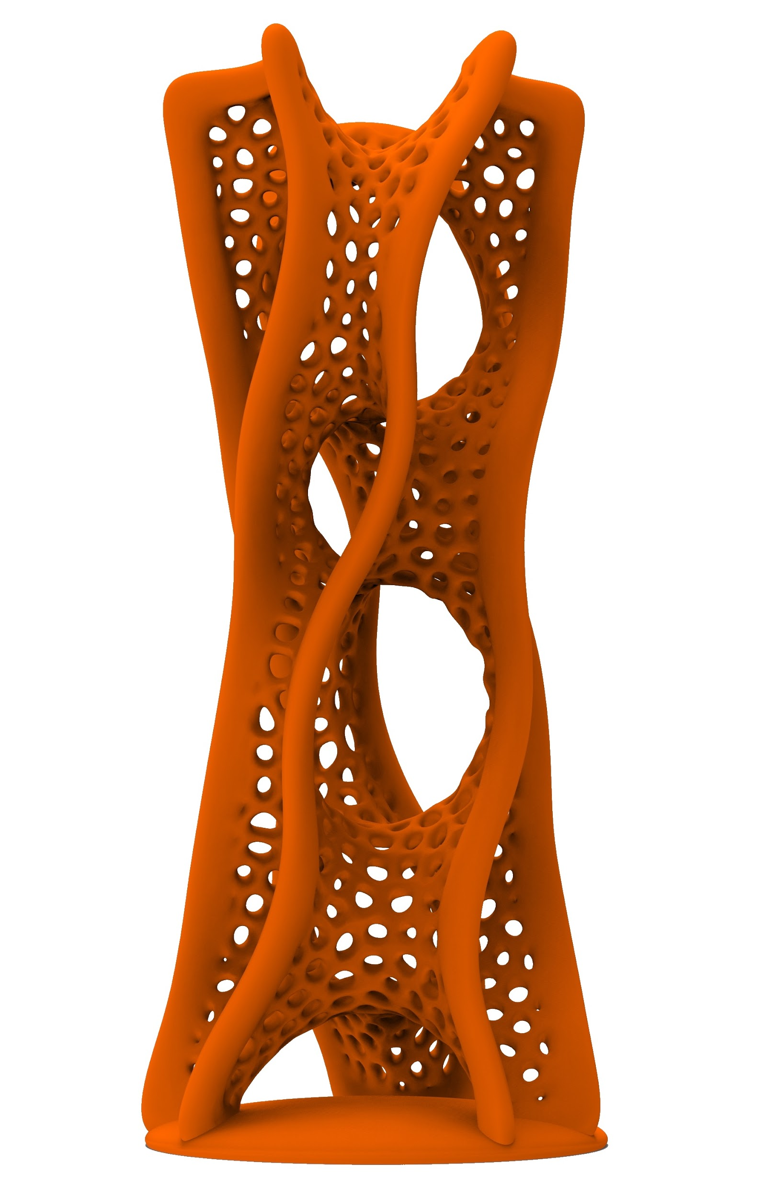

Mr.sc. Roberto Vdović
Dimenzija
(ni)je važna
PRINT.Fest
Dani s Gospodinom Printom
Hotel Sheraton 9.3.2016.

Slide 2
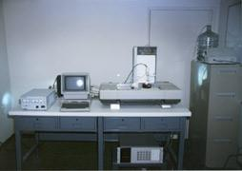
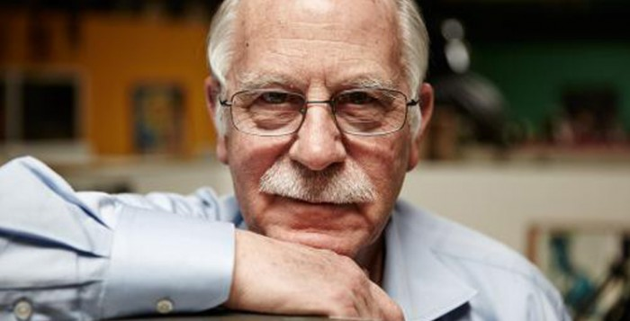
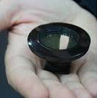
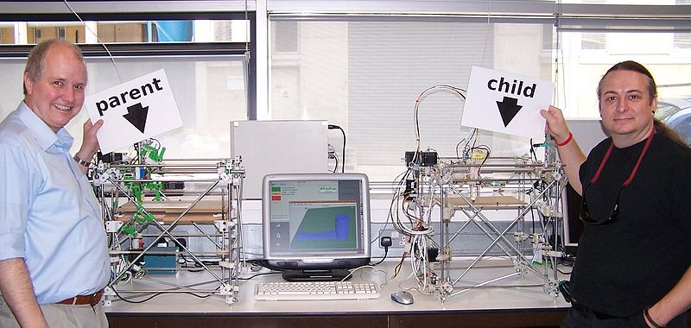
History
2/11
1958.
prvo glodalo spojeno na računalo CNC (M.I.T.)
1983.
prvi uređaj za 3D ispis (Chuck Hull)
1986.
patentirana stereolitografija
SLA, UV laser (Chuck Hull)
1989.
Laser sintering
SLS metale
(Carl Deckard)
1996.
prvi komercijalni uređaj
(3D Systems)
2005.
RepRap projekt
FDM > FFF
(Adrian Bowyer)
2013.
30 godina od prvog 3D ispisanog predmeta

Slide 3
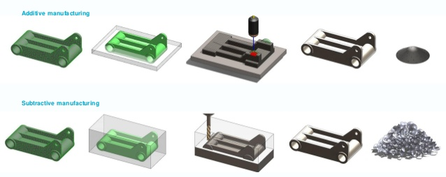
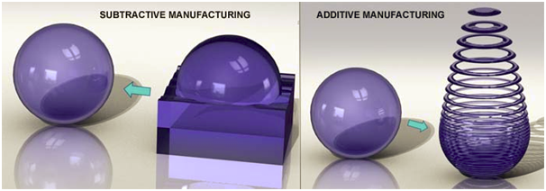
Additive vs. Substractive
3/11

Slide 4
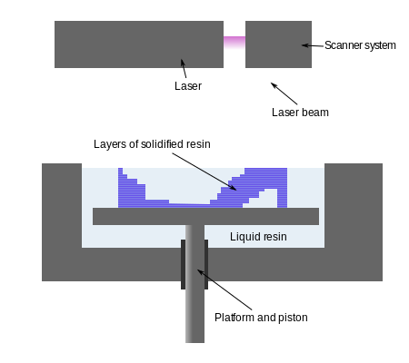
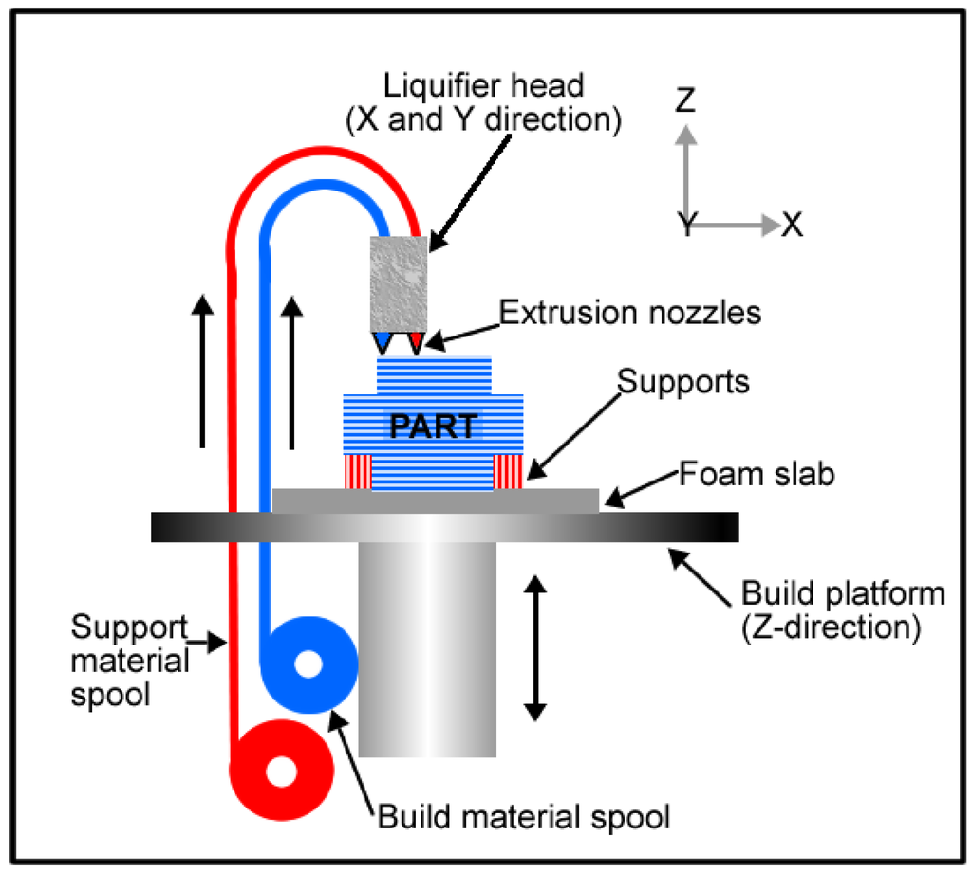
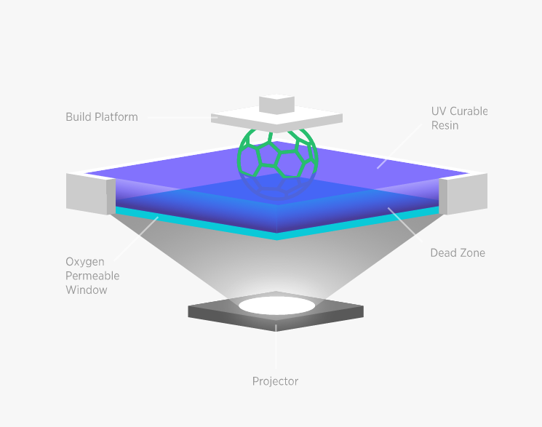
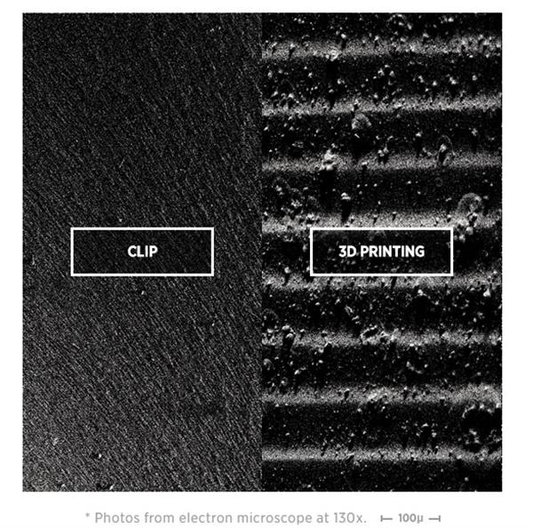
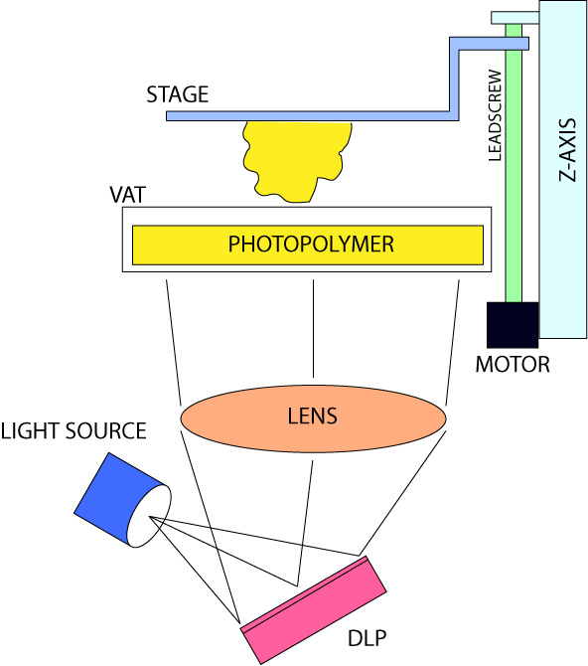
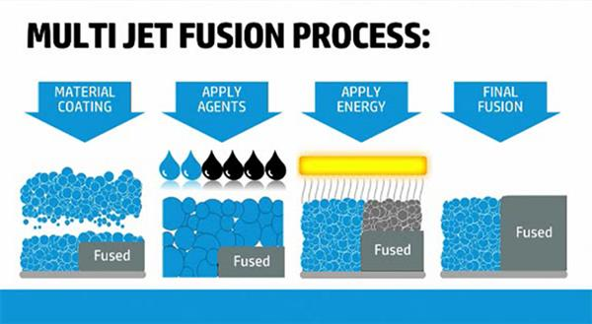
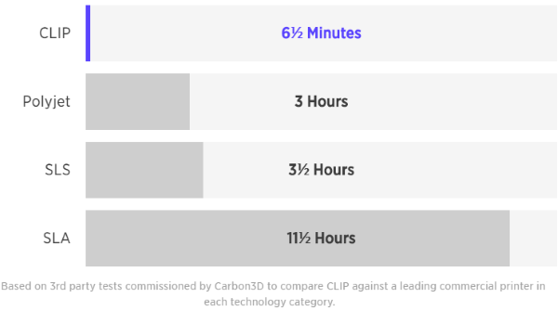
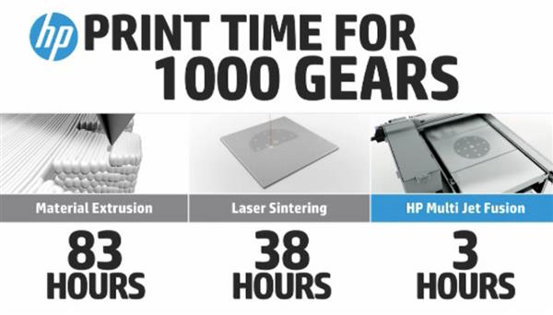
Additive technologies
4/11
SLA
FDM / FFF
CLIP
DLP
MULTI JET

Slide 5
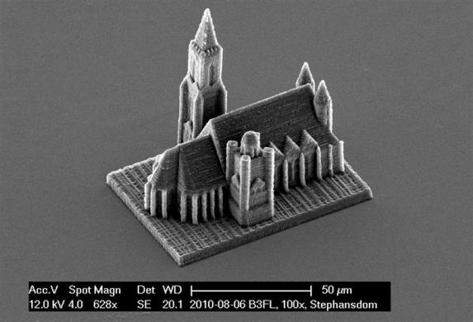
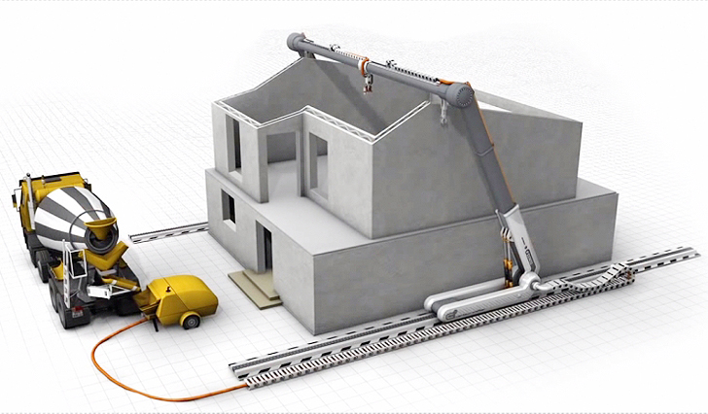
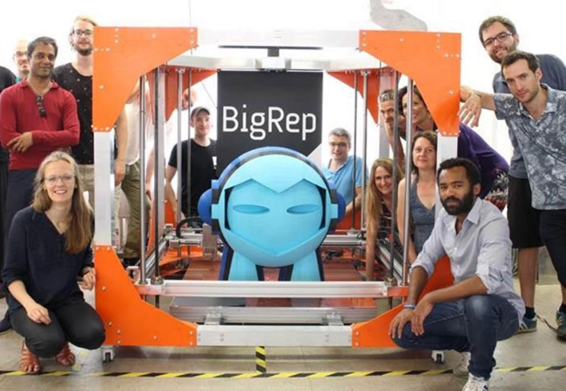
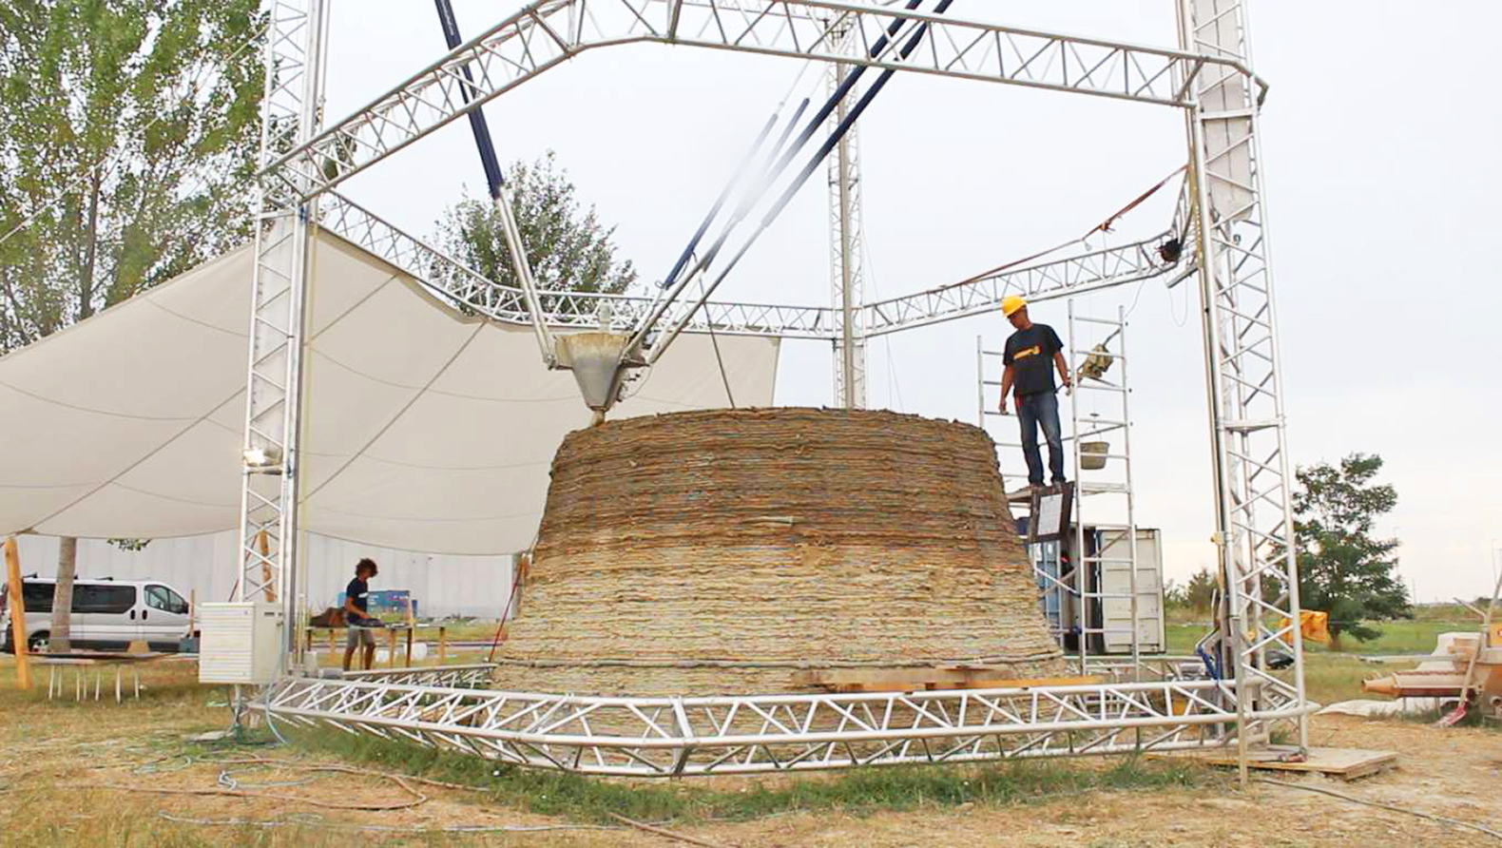
Scale
5/11

Slide 6
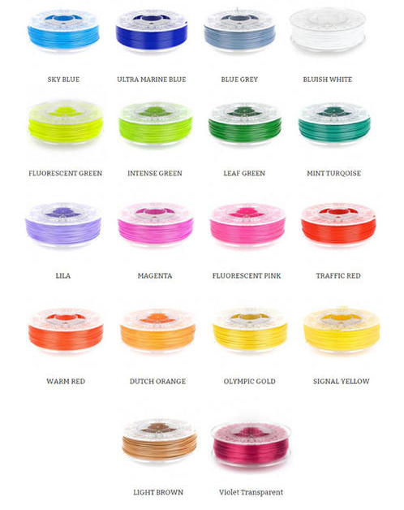
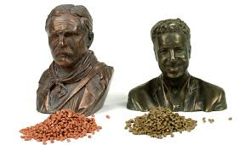
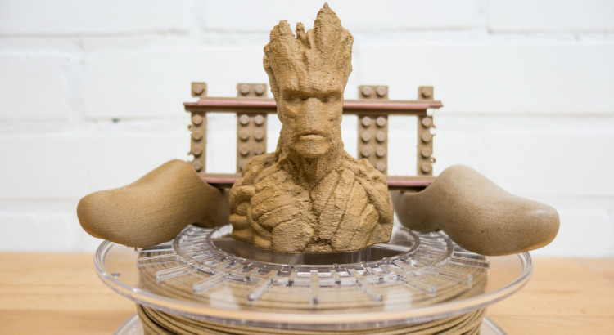
Filament
Polylactic acid (PLA), ABS, Nylon,...

Slide 7
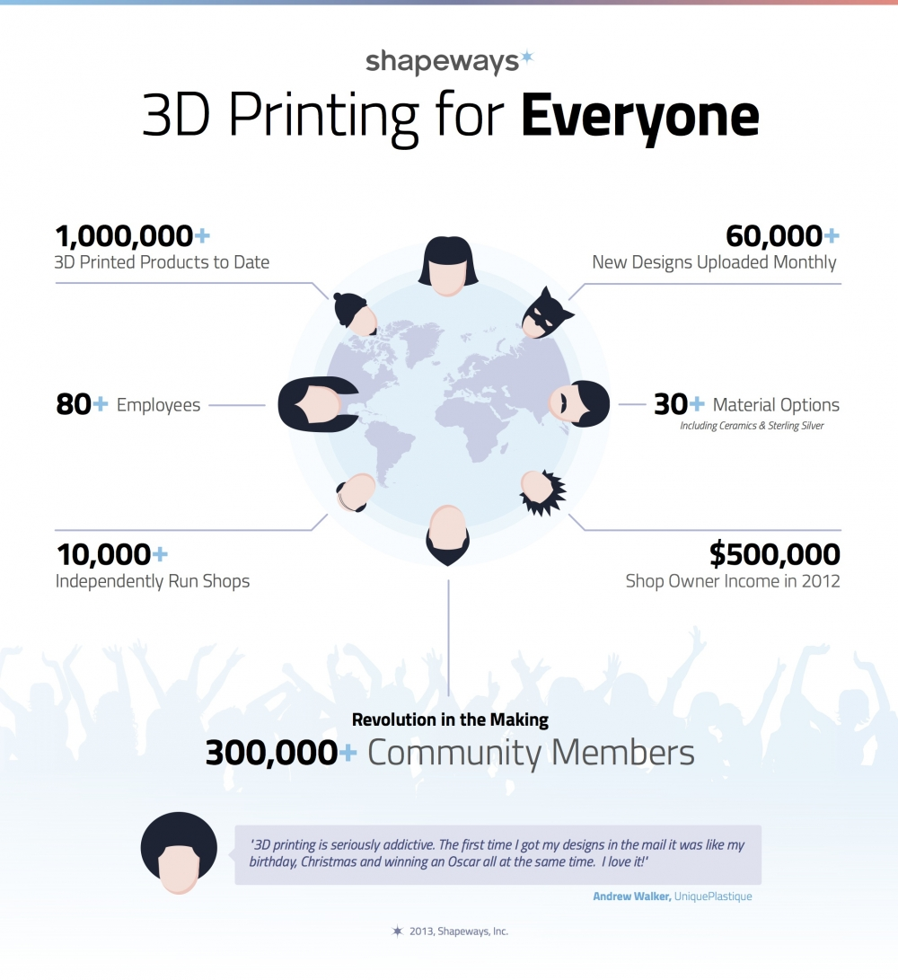
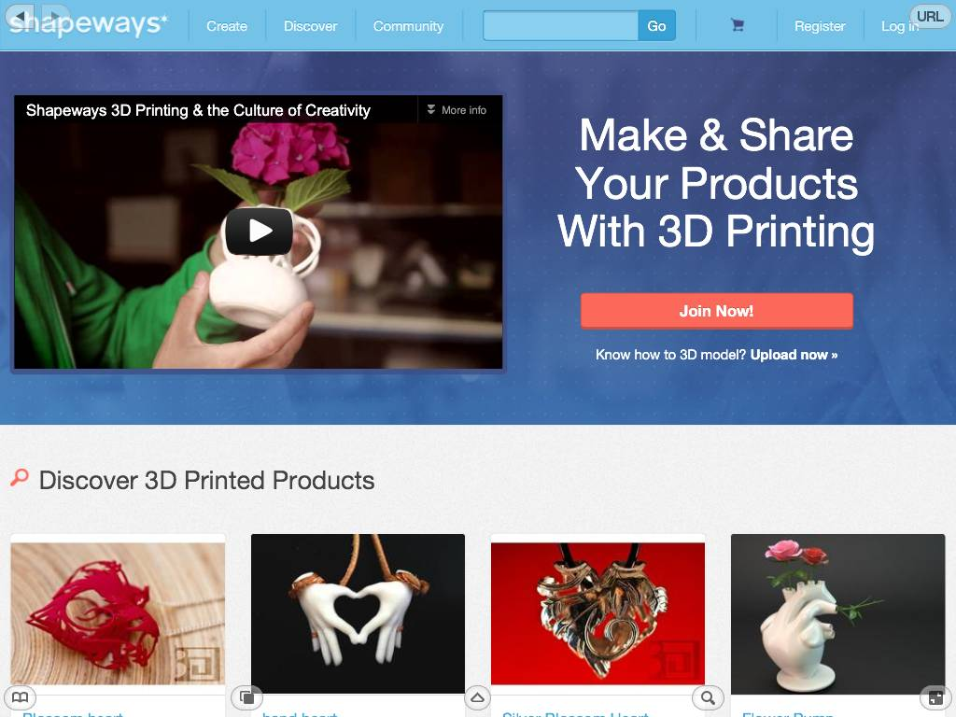
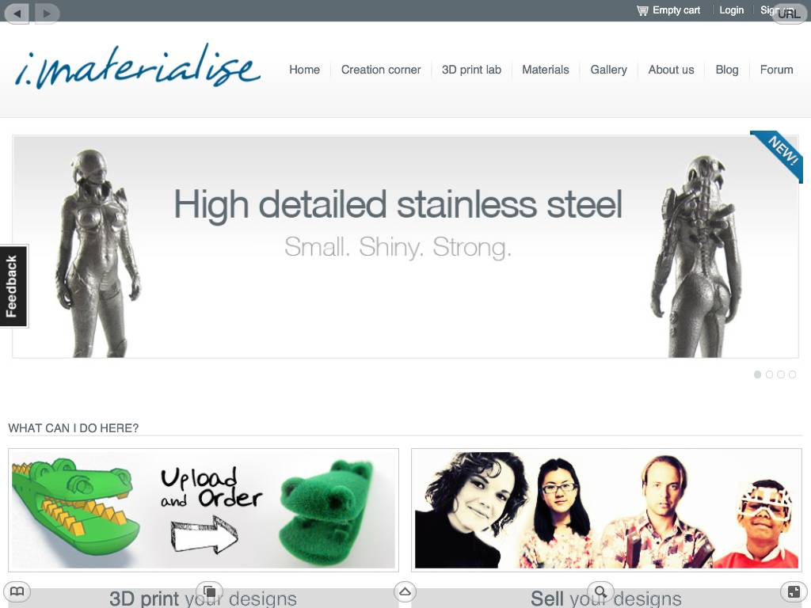
(Global) 3D printing services
6/11
www.shapeways.com NL > USA
www.sculteo.com
FR
http://i.materialise.com/
BE

Slide 8
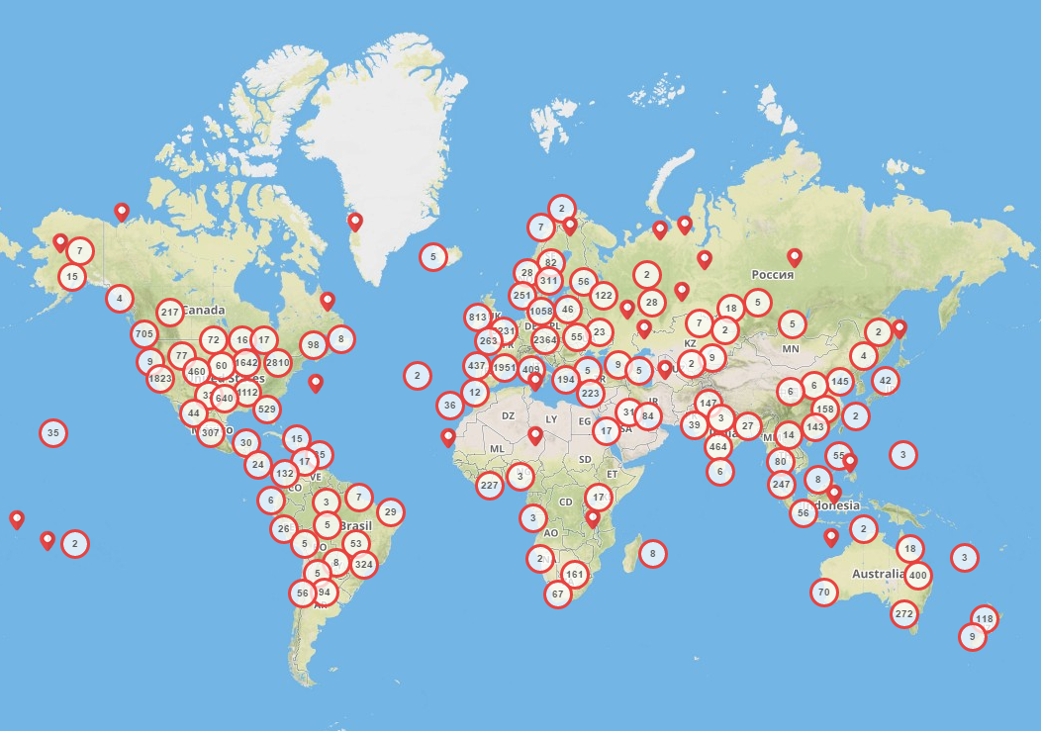
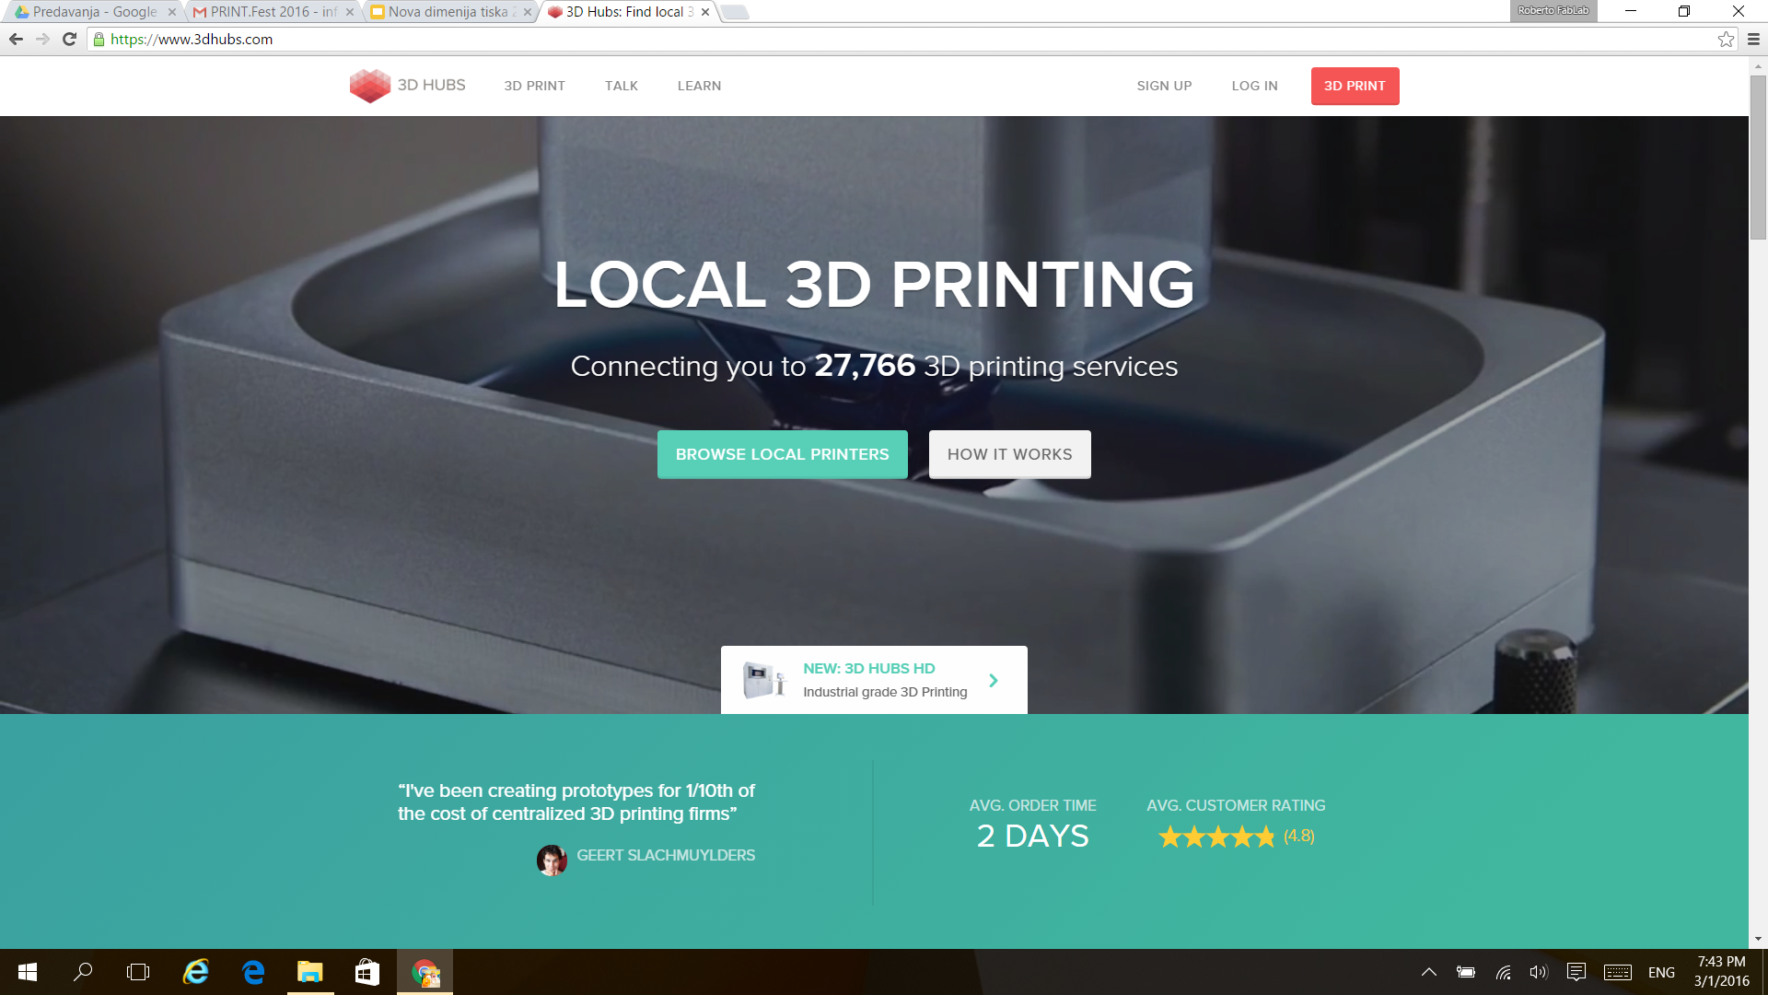
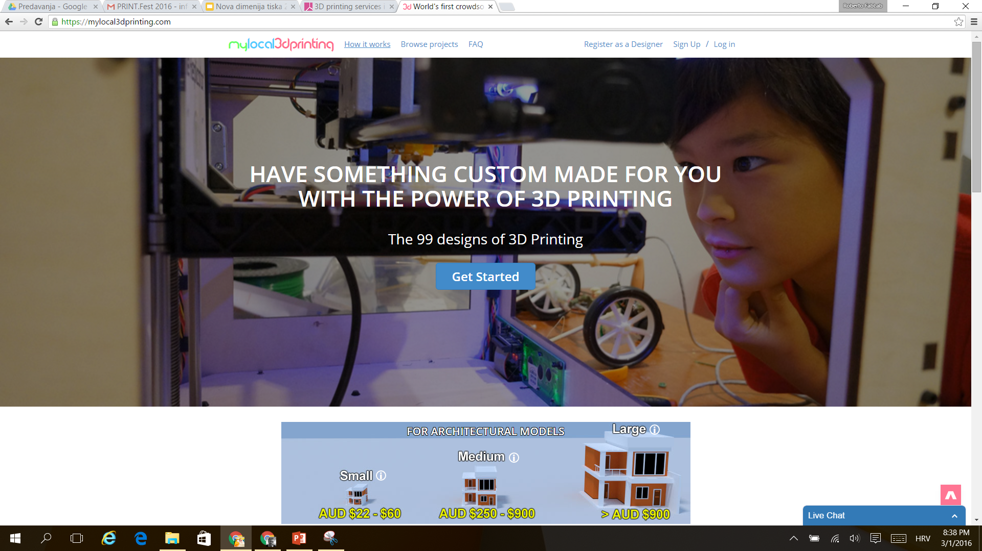
(Local) 3D hubs
7/11
www.3dhubs.com
mreža 27.769 printera
www.makexyz.com

Slide 9
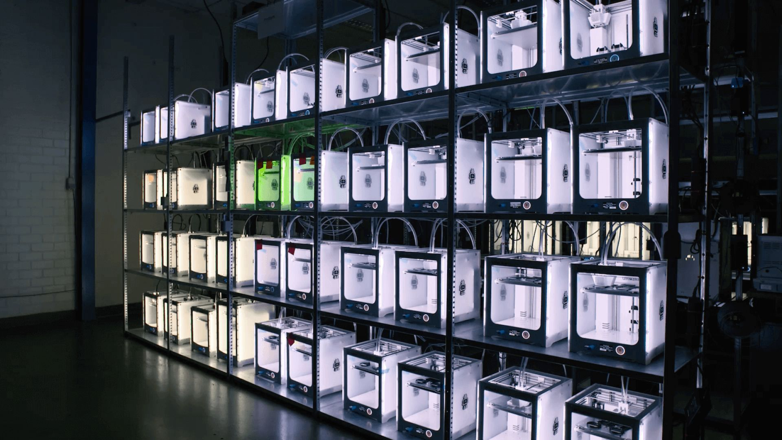
Bridge manufacturing
8/11

Slide 10
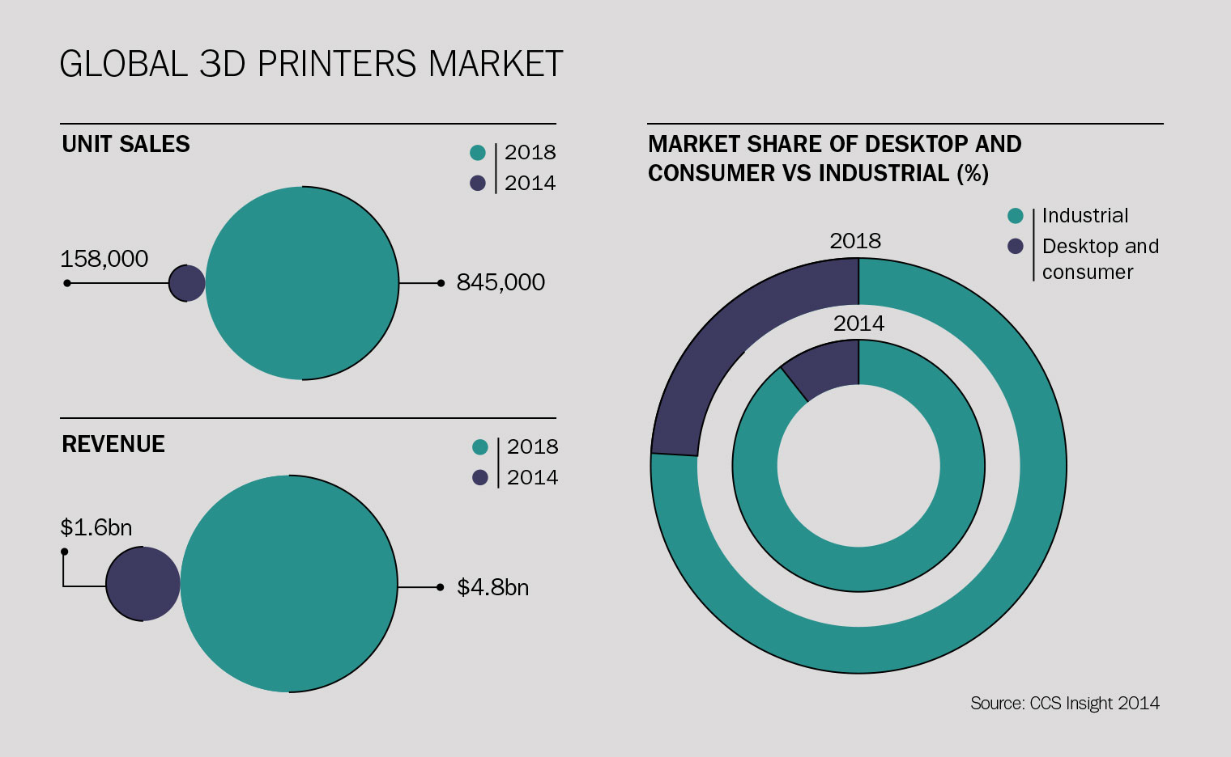
3D printers market, 2014 > 2018
9/11

Slide 11
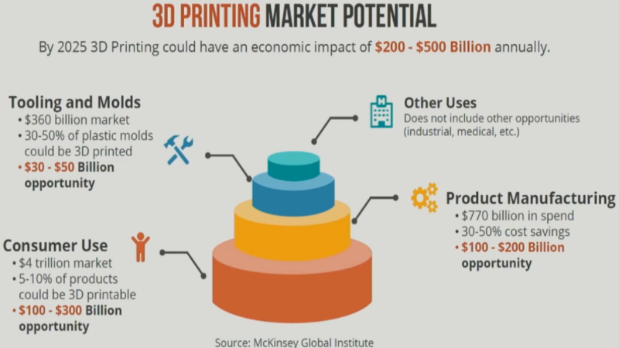
3D printing market potential by 2025
10/11

Slide 12
Q&A
11/11
Roberto Vdović
roberto.vdovic@arhitekt.hr
FabLab.HR
info@fablab.hr

