Slide 1
Solvent-less Water based Inks for
Non Porous Substrates
Igor Belošić, MBA, M. Eng.
Matjaž Mramor, DFTA

Slide 2
Today
Solvent Based Inks serve us well
However…
DECADES OF INNOVATION
Solvents are a non-renewable resource
Now with “universal” products
They present a
management control burden and – even if small – a risk
Provide a full range of possibilities
Cost effective

Slide 3
In Future
The alternatives must meet market demands for:
Productivity (speed / down time for
cleaning)
Technical performance (physical)
Total cost of ownership
Quality
of graphics

Slide 4
Your choices
Water-
based
inks
Water-based Electron Beam (EB) cured inks
Offset
options
Electron Beam (EB) cured inks
Flexo/
gravure options
Wetflex
Conventional
UV cured inks
Conventional UV flexo inks

Slide 5
Water-
based
inks
Water-
based
inks
Water-based Electron Beam (EB) cured inks
Water-based Electron Beam (EB) cured inks
Electron Beam (EB) cured inks
Electron Beam (EB) cured inks
The Menu…
Wetflex
Wetflex

Slide 6
Overall Statement Europe
a
The total use of inks and coatings in the European flexible packaging industry is estimated to ~200,000 tons per year
Less than 10,000 tons are WB (~5%)
Full conversion of plants to WB inks has only been done in the PE converting industry (for garbage and mailing bags for instance)
No major generalist converters have fully migrated to WB
  WB inks are less polyvalent than SB
  Negative impact on press speed, especially with backing white
  Regulations have not reached a point where SB are no longer suitable

Slide 7

Applications Space Water Based Inks for flexible packaging

Slide 8
Diapers, towels wrap
Garbage bags
In-line extruded PE bags
Metallised gift wrap
Cups, plates
Carrier bags
Deep freeze pouches
Non-woven
PE
OK Compost bags
Outdoor bags, pallet hood
Foil
Other films
Magazine wrap
Butter packaging
Adhesive tapes
Shrink sleeves
Food, snack pouches
Laminated food pouches

Slide 9
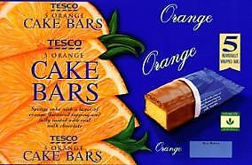
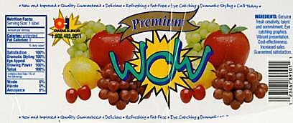
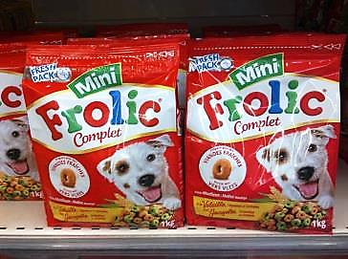
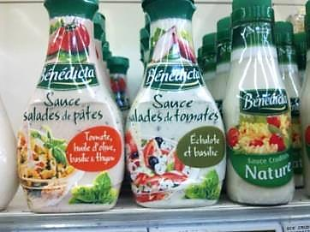
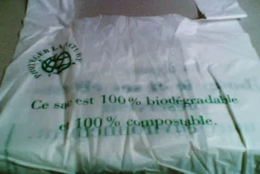
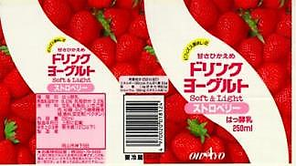
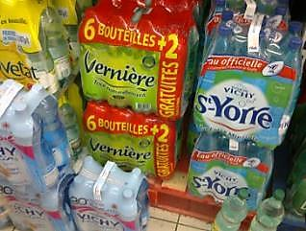
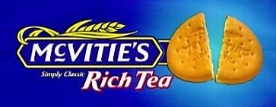
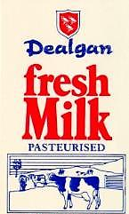
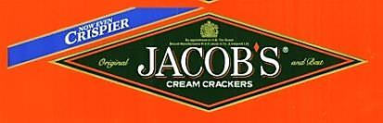


Applications space – examples
Direct print on PE, PP & PET
Lamination PET/PE
Reverse on Sleeves
OK Compost
Direct on board/PE or board/PP
Reverse on PE
Direct print on PVDC

Slide 10
What Does Each Technology Offer?
Water-
based
inks
Water-
based
inks
Water-based Electron Beam (EB) cured inks
Electron Beam (EB) cured inks
A cost effective option
Resistant surface print options available(after polimerisation like „glass” on surface-excellent adhesion, scratch resistance, fett resistance, water resistance)
Wetflex
Water-based Electron Beam (EB) cured inks
Can be printed on existing presses
Electron Beam (EB) cured inks
Water-
based Inks
Boost air flow for higher speeds
Excellent for
process printing
Suitable for Flexo and Gravure
HD also an option
Wetflex
Suited to lamination

Slide 11
Summary
Water-based flexo / gravure inks are a good low cost option for lamination and can be printed on existing presses
Electron Beam water-based versions are required for surface print with good resolubility
WetFlex specifically offers gravure quality high speed printing and is an “Ultra Press friendly” solution
Electron Beam Offset is the best option for fast turnaround / short run with low cost plates based on the extended gamut concept

Slide 12
Shift of ink material structure and cost
20-30% lower consumption of whites and overprint varnish
  Finer anilox rollers with WB for lower transfer/cost effective
Stronger coloured bases
  +100% TV in finished inks)
No need of let-down solvent (~30% of SB ink volume)
  Replace by ~5% of let-down water
No need of “viscosity” solvent
SB
Solvent
WB
Water
Technology varnish
Technology varnish
Coloured base
Coloured base
Notes:
SB boja – puno pigmenta radi loseg transfera…
Nema podešavanje više viskoziteta … kod vodene – jedna briga manje! Čovjek manje..
Pigment WB nije RASTPOLJEN(DISOLVED) VEĆ JE DISPERGIRAN.
prednost toga je stabilnost otiska i boja se može puno jače pigmentirat.

Slide 13
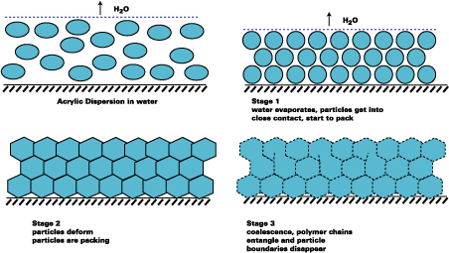
Fundamental difference between SB and WB inks: film-forming stage
Dispersed resin is insoluble in water at all pH
  There is in principle no resolubility of ink into itself once dispersed resins starts to coalesce (resin micelles fuse together)
  This fundamental effect drives every aspect of printing WB inks
Film forming mechanism of WB inks: coalescence
  Entirely new mechanism / solvent-based
  Coalescence is slow: full properties take 48-72 hrs to develop
  Sun Chemical inks generally have key advantage with properties at t=0
Drying
Acrylic dispersion in water
Stage 1
Water evaporates, particles get into close contact, start to pack
Coalescence
Stage 2
Particles deform
Particles are packing
Stage 3
Coalescence, polymer chains entangle and particle boundaries disappear

Slide 14
Cost matters
Accurate cost-in-use comparison is not easily available
WB inks are 20-35% more cost efficient than SB inks (inks + solvent)
  Approx -20% for large plants using ~250 tons of inks per annum
  Approx -25% for small plants using ~40 tons of inks per annum
Main differences are
  WB inks require more energy for drying (no auto feed from solvent) – but no incineration!
  WB inks have higher waste treatment cost
  WB inks are cheaper per m²

Slide 15
A project that impacts the whole company
Investments Running costs
Productivity
Impact on sales
Business
Health / safety
Workers motivation
Image
Rules
Quality
Performance
Human
Technical

Slide 16

First of all, moving to WB means…
Facing resistance
to changing
work habits.
Requires:
  Strong leadership
  Motivation

Slide 17

And then, moving to WB means…
A source of
frustration.
Requires:
  Clear and shared objectives
  A clear roadmap
  Anticipated road-blocks

Slide 18

Conclusions
WB inks are mature enough to address most challenges
Newest presses are well designed to run WB but some older presses can be retro-fitted without excessive costs. Speed will be limited by drying
Corona treatment is mandatory (no exceptions)
Sun Chemical have vast and deeply rooted expertise

Slide 19
Sun Chemical’s Technology concept
SunSpectro Aqua and SunStrato Aqua are Sun Chemical’s product families of WB inks for films and foil
A single Coloured base range + bespoke technology varnishes
Dedicated portfolio of finished products:
  AquaLam Laminated structures
  AquaThene Polyethylene applications and Biodegradable films (carrier, outdoor, deep freeze, shrink wraps, garbage…)
  AquaFoil Aluminium foil
  AquaSleeve Shrink sleeves
  AquaProp Non-Woven, salad and snack pouches
  AquaTape Adhesive tapes

Slide 20

THANK YOU! igor.belosic@sunchemical.com

