Slide 1
Addressing sector demands for high-clarity, sustainable packaging with: Clarifying agents UV absorbers
Ruben Subira - Regional Market Manager

Slide 2
Addressing sector demands for high-clarity, sustainable packaging with: Clarifying agents

Slide 3
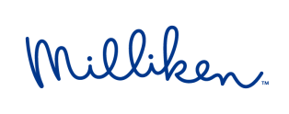
We Make Polypropylene Clear
PP often described as
‘Milky’ or ‘Translucent’
PP clarified with Millad NX 8000
An innovative clarifying technology from
Clarified PP can be now alternative for PET, PS, PC, SAN…
/29

Slide 4
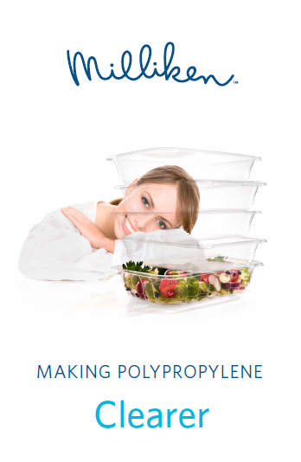
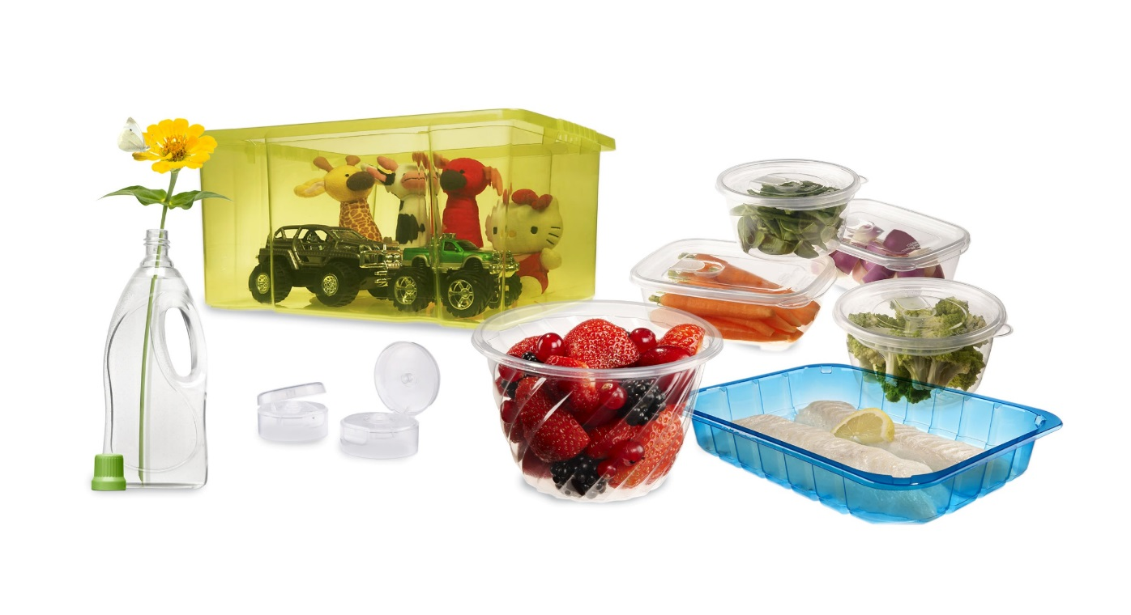
Making Polypropylene Clearer
With Millad NX 8000
NX™ UltraClear PP in thermoformed applications
NX™ UltraClear PP in blow molded applications
NX™ UltraClear PP in injection molded applications
Millad® NX™ 8000 - Bringing clarity to products worldwide
©2016 Milliken & Company
/29

Slide 5
Making Polypropylene Clearer
With Millad NX 8000
NX™ UltraClear PP in thermoformed applications
NX™ UltraClear PP in blow molded applications
NX™ UltraClear PP in injection molded applications
Millad® NX™ 8000 - Bringing clarity to products worldwide
©2016 Milliken & Company
/29

Slide 6
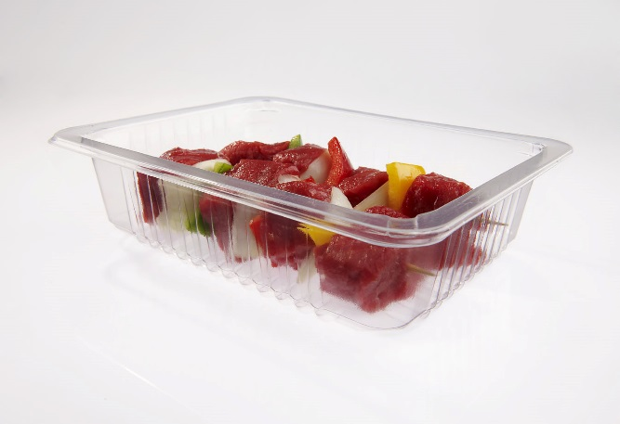
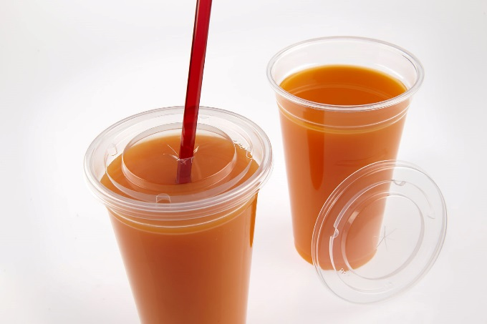
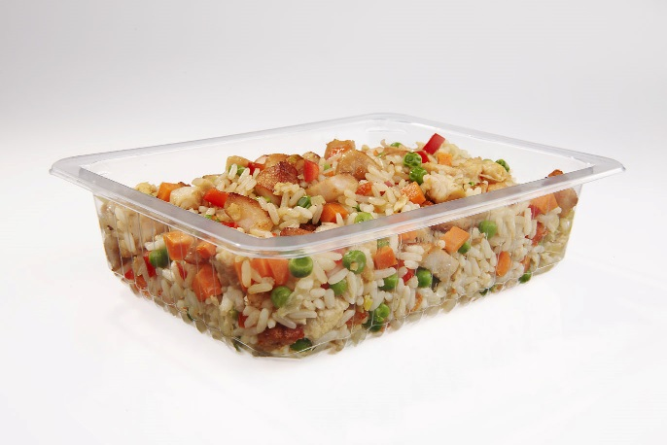
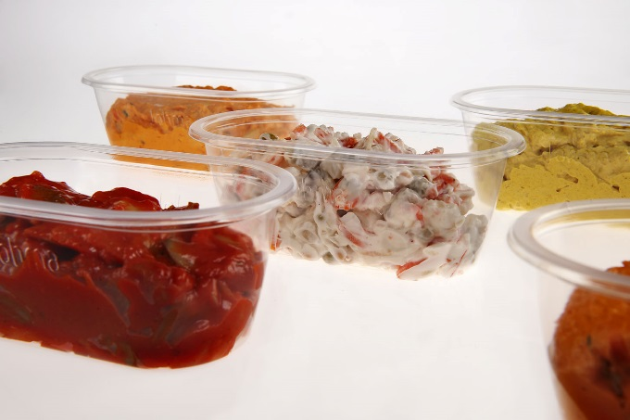
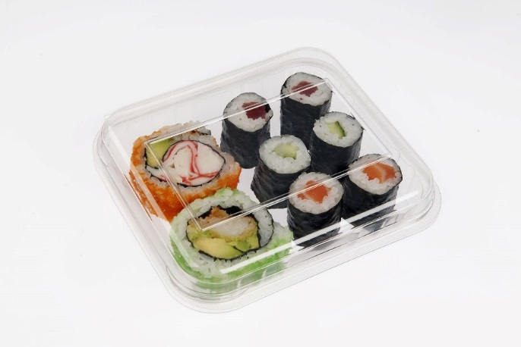
Making Polypropylene Clearer
With Millad NX 8000
High transparency
Milliken’s innovation overcomes the traditional undesirable milky appearance of PP, creating highly-attractive transparency similar to PET and PS
©2016 Milliken & Company
/29

Slide 7
UltraClear Polypropylene
With Millad NX 8000
1 million PET Trays
Weight 17,4 Ton
1 million Ultra Clear PP Trays
Weight 14,3 Ton
Carbon Footprint 78700 kg CO₂ EQ
Carbon Footprint 49421 kg CO₂ EQ
Lighter and sustainable
Lower density PP UltraClear trays offer lightweight and more sustainable, lower carbon footprint alternatives at equivalent PET transparency. 18% lower weight and 37% less CO2
/29

Slide 8
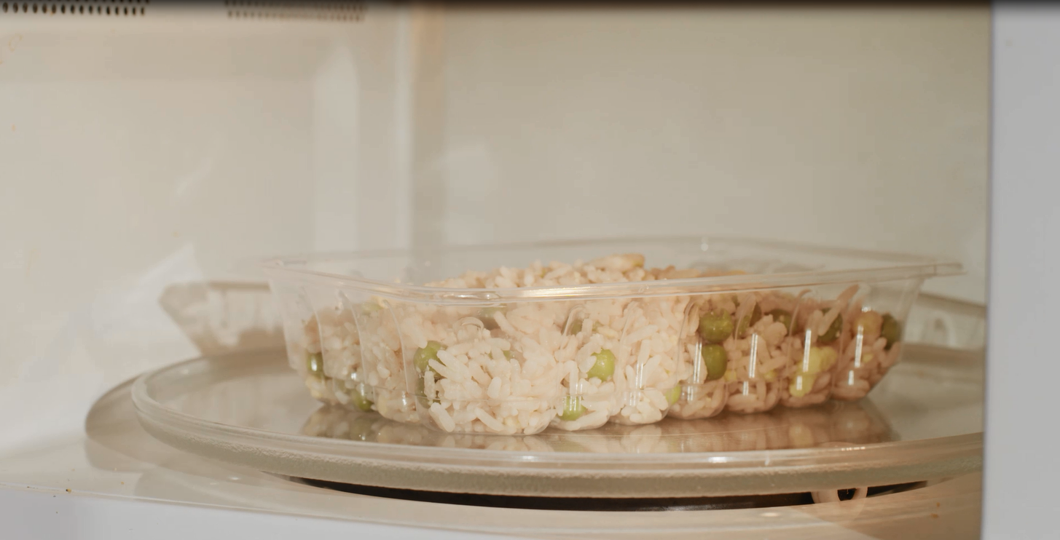
Making Polypropylene Clearer
With Millad NX 8000
Microwaveability - Hot fill
The material’s excellent heat resistance further
extends application opportunities by enabling
microwaveability and hot fill capability.
©2016 Milliken & Company
/29

Slide 9
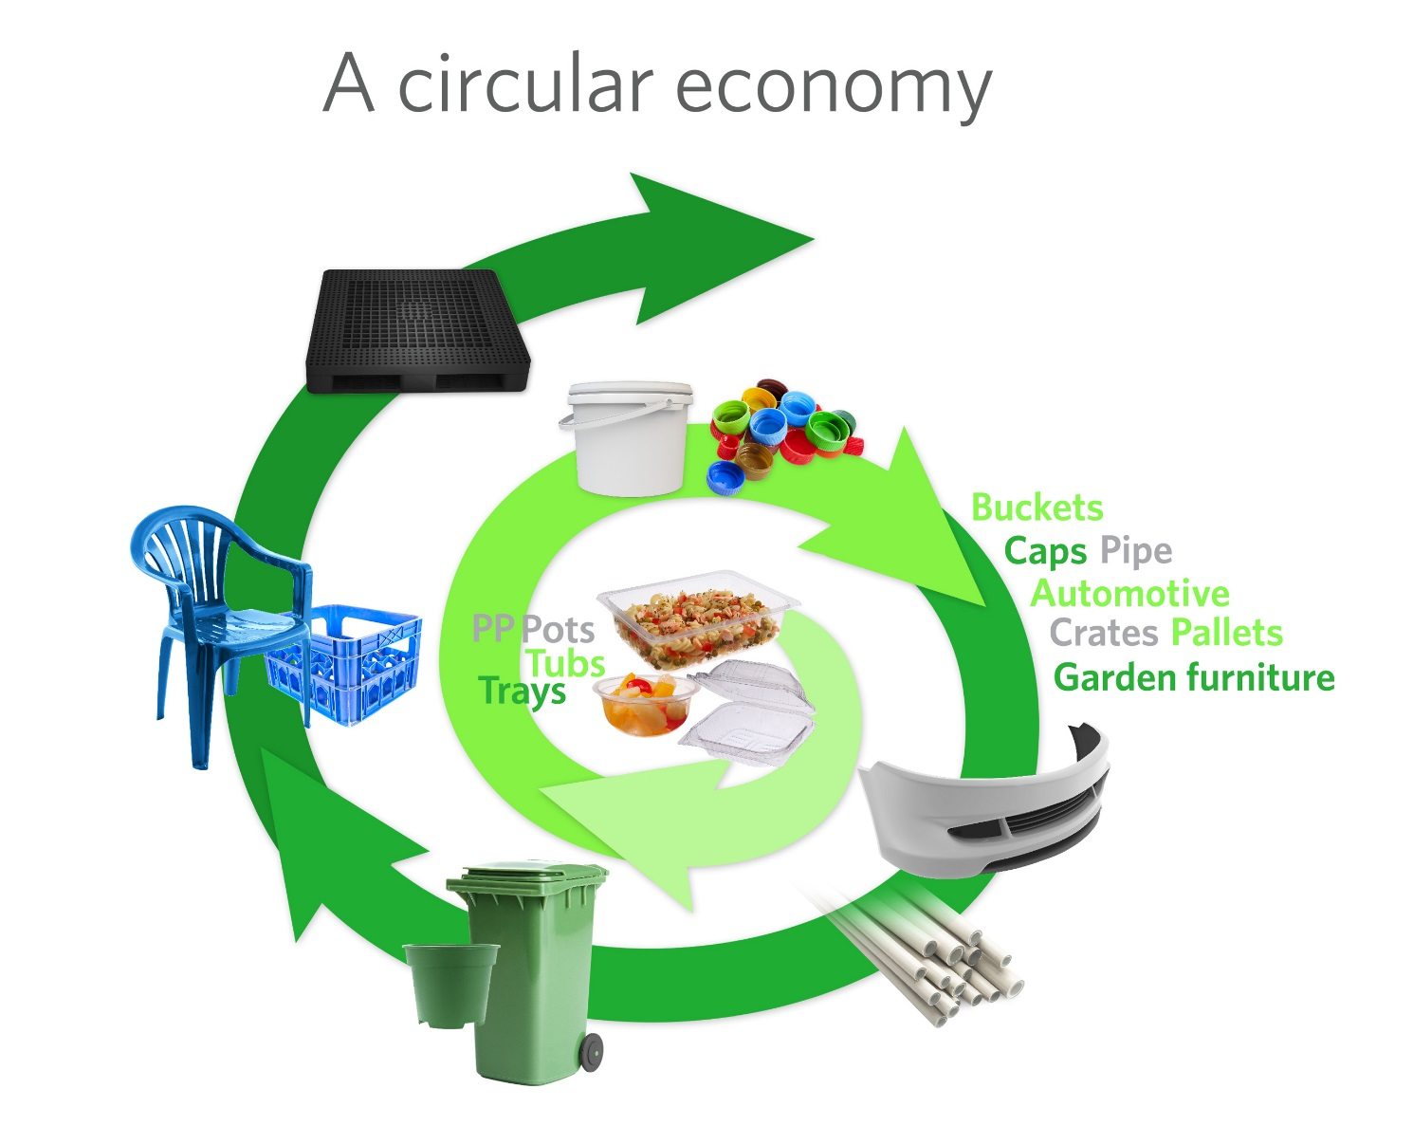
Making Polypropylene Clearer
With Millad NX 8000
Recycling opportunity
PP offers a circular economy which results in end-of-life solutions for applications. There is an existing market for recycled PP (rPP) in a wide range of products such as caps and closures, buckets, automotive applications, pipes, pallets and garden furniture
©2016 Milliken & Company
/29

Slide 10
Making Polypropylene Clearer
With Millad NX 8000
NX™ UltraClear PP in thermoformed applications
NX™ UltraClear PP in blow molded applications
NX™ UltraClear PP in injection molded applications
Millad® NX™ 8000 - Bringing clarity to products worldwide
©2016 Milliken & Company
/29

Slide 11
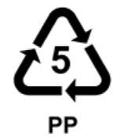
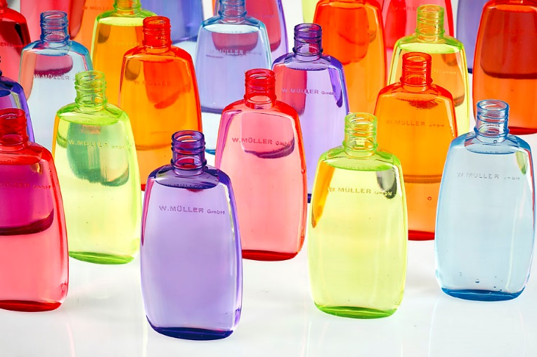
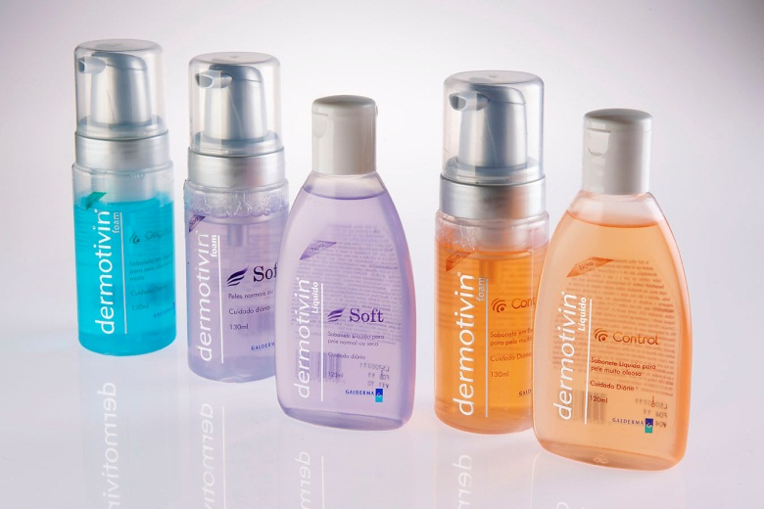
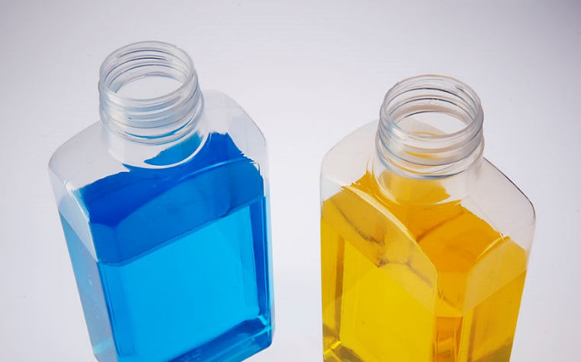
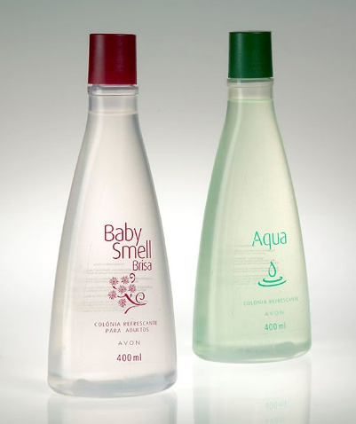
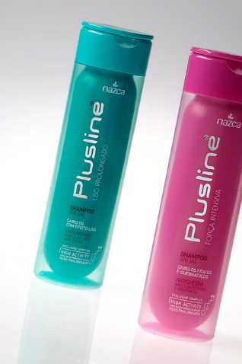
Making Polypropylene Clearer
With Millad NX 8000E
UltraClear PP offers alternative to PET & PVC
High Clarity - Increased consumer appeal of packaged goods
/29

Slide 12
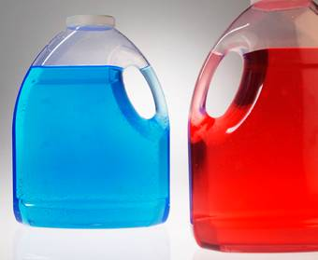
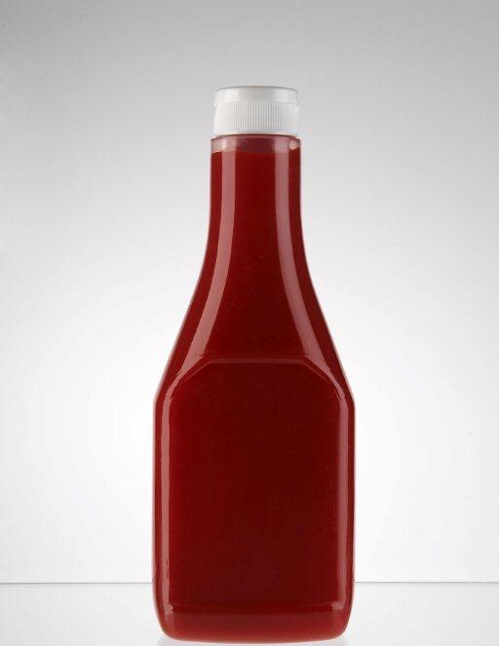
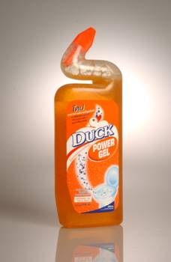
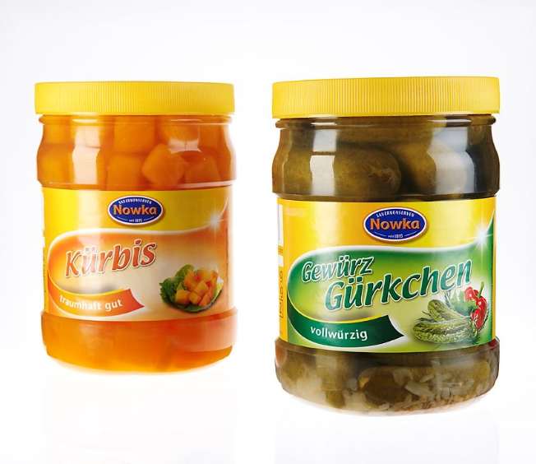
Making Polypropylene Clearer
With Millad NX 8000E
Hot fill, complex mold design
The material’s excellent heat resistance further
extends application opportunities by enabling
hot fill capability. Allows processing of complex bottle geometry, handle ware
©2016 Milliken & Company
/29

Slide 13
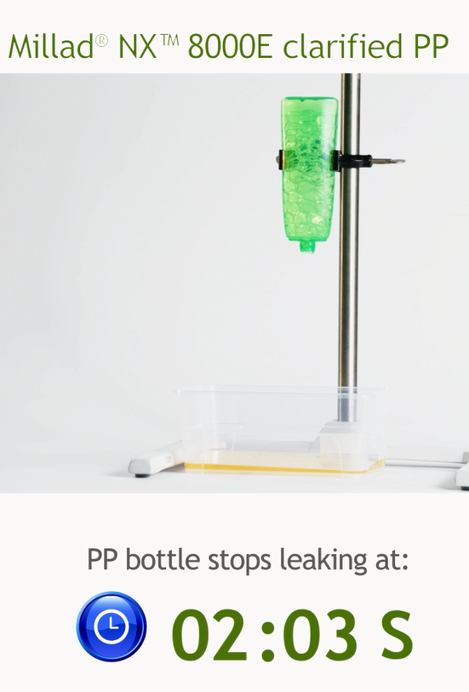
Making Polypropylene Clearer
With Millad NX 8000E
Easy to empty
The polypropylene blow-molded bottle, is easier and faster to empty than other solutions.
©2016 Milliken & Company
/29

Slide 14
Making Polypropylene Clearer
With Millad NX 8000E
1 million PET Bottles
Weight 22,8 Ton
Weight 18,0 Ton
1 million UltraClear PP Bottles
20 %
lighter than PET
©2016 Milliken & Company
/29

Slide 15
Making Polypropylene Clearer
With Millad NX 8000E
Recycling opportunity
PP offers a circular economy which results in end-of-life solutions for applications. There is an existing market for recycled PP (rPP) in a wide range of products such as caps and closures, buckets, automotive applications, pipes, pallets and garden furniture
©2016 Milliken & Company
/29

Slide 16
Making Polypropylene Clearer
With Millad NX 8000
NX™ UltraClear PP in thermoformed applications
NX™ UltraClear PP in blow molded applications
NX™ UltraClear PP in injection molded applications
Millad® NX™ 8000 - Bringing clarity to products worldwide
©2016 Milliken & Company
/29

Slide 17
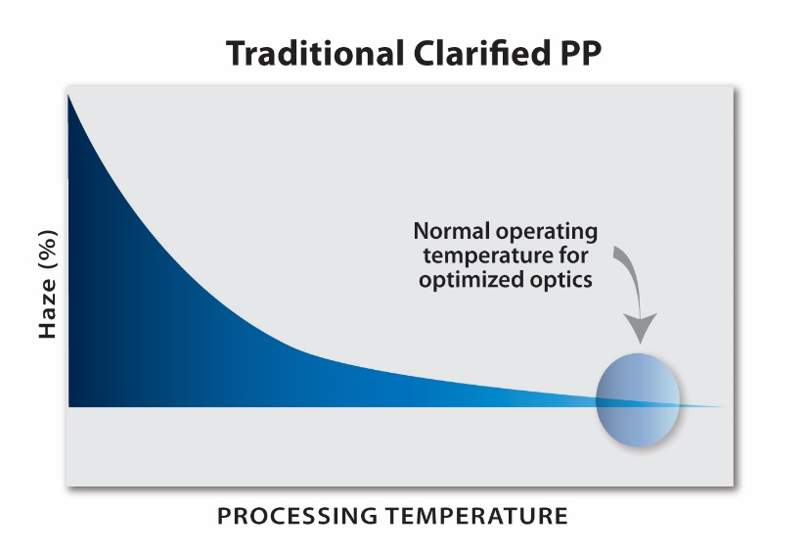
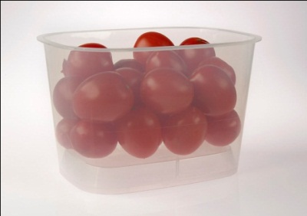
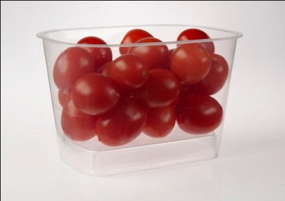
Making Polypropylene Clearer
With Millad NX 8000
Energy savings
Millad NX 8000 allows for low temperature and cycle time processing compared to traditional clarified PP, being more sustainable
Lower Process Temperature
CO₂ Reductions
Lower Energy
DMDBS
Millad NX 8000
/29

Slide 18
Making Polypropylene Clearer
With Millad NX 8000
PS
UltraClear PP
1 kg PS = 75 lids
1 kg PP = 98 lids
23 % Weight reduction
Light Weight material
Together with PE, PP has the lowest density of all plastics, allowing for reduced packaging weight, reduced transport cost, reduced waste, reduced eco-tax
©2016 Milliken & Company
/29

Slide 19
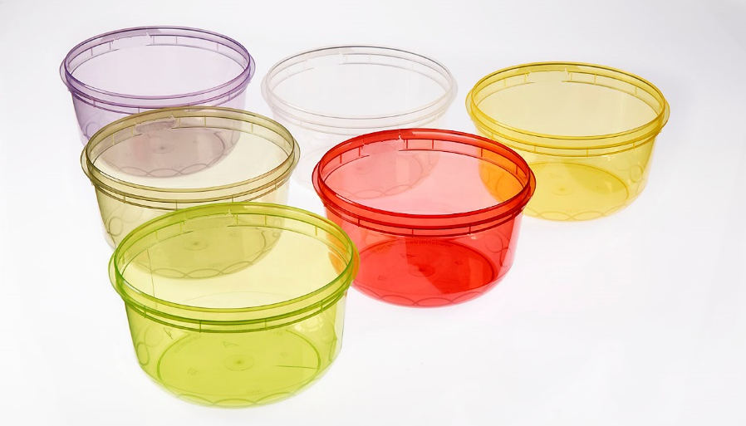
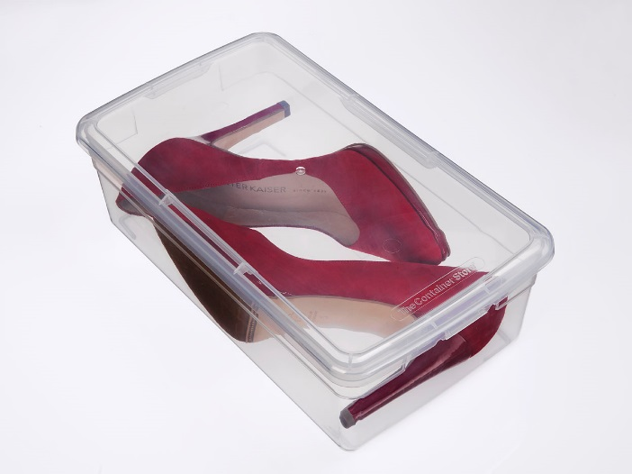
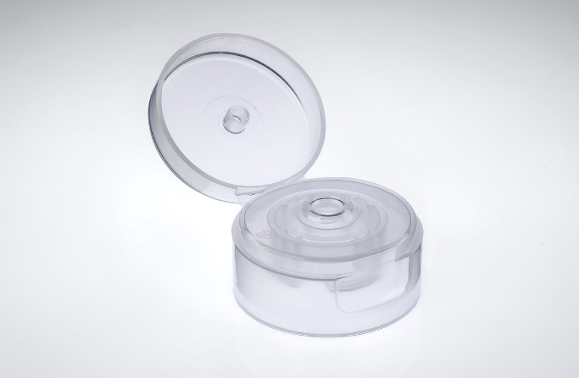
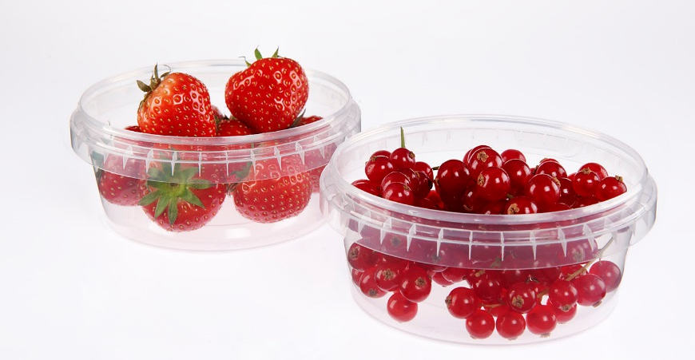
Making Polypropylene Clearer
With Millad NX 8000
Ultra-Clear PP offers alternative choice to PC, PS, PMMA
High Clarity - Increase consumer appeal of packaged goods
/29

Slide 20
Making Polypropylene Clearer
With Millad NX 8000
NX™ UltraClear PP in thermoformed applications
NX™ UltraClear PP in blow molded applications
NX™ UltraClear PP in injection molded applications
Millad® NX™ 8000 - Bringing clarity to products worldwide
©2016 Milliken & Company
/29

Slide 21
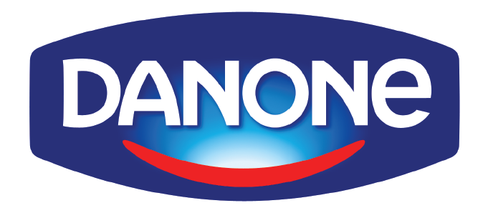
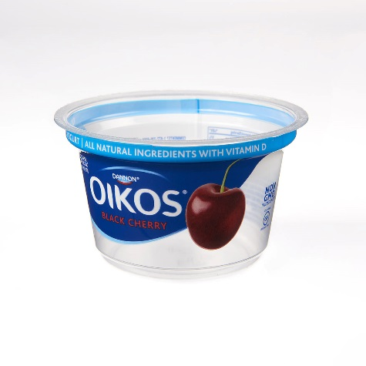
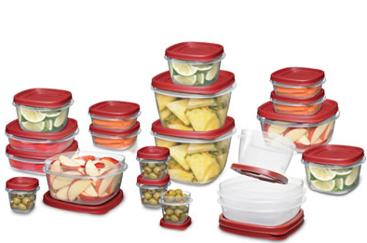
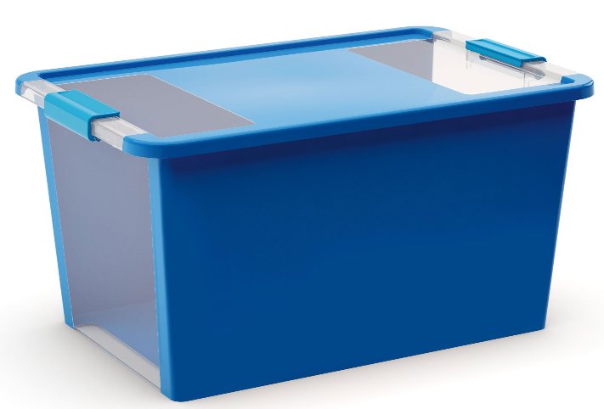
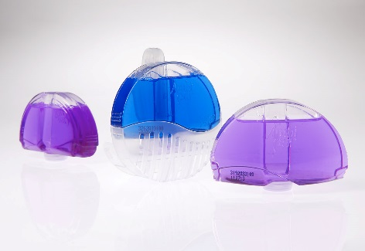
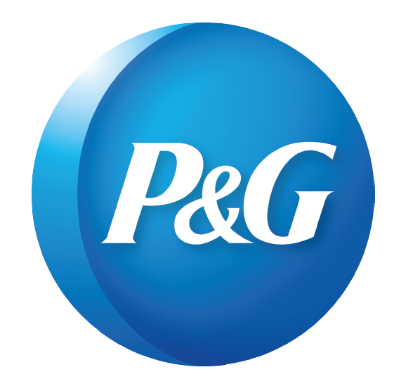
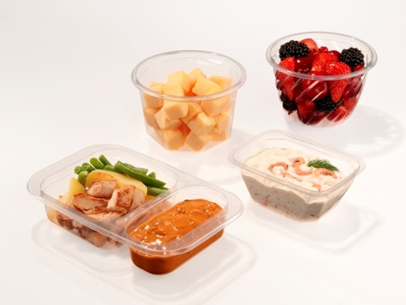
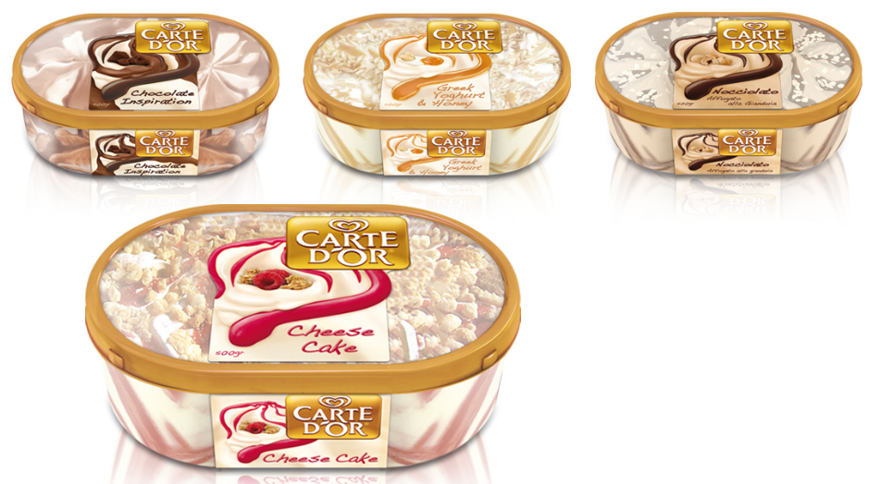
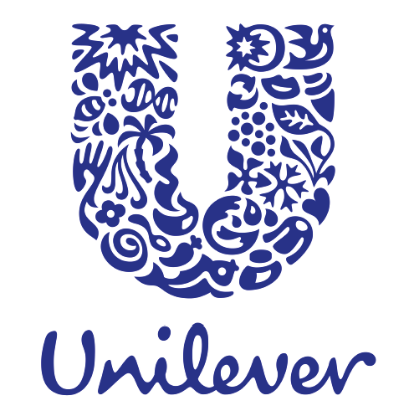
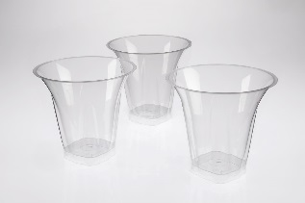
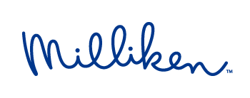
Bringing clarity to products worldwide
With Millad® NX™ 8000
©2016 Milliken & Company
21
/29

Slide 22
Addressing sector demands for high-clarity, sustainable packaging with: UV absorbers
22
/29

Slide 23
PET bottles
Shelf-Life and Shelf-appeal is Critical to Brand-Integrity
Delivering a consistent product experience is critical
Key brand elements
Color and appearance
Aroma
Functional or nutrient qualities
Shelf-life affected by
Formulation (ingredients, pH, stabilizers)
Environmental (light, temperature, humidity)
Package design
Reduce formulation complexity and add UV absorber to PET
/29

Slide 24
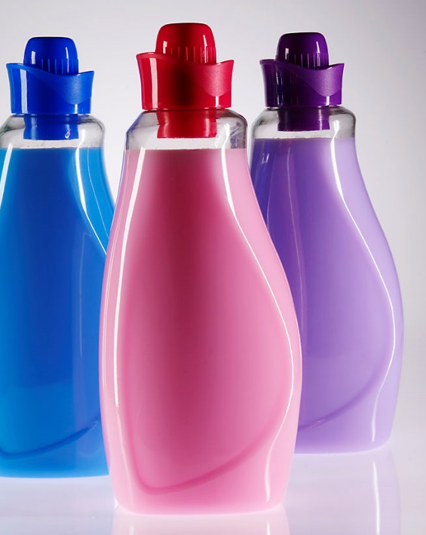
The UV Problem
Exposure to sunlight or indoor lighting during storage, distribution, retail display, and post-purchase storage
…reducing the profits of the supply chain
Increased supply costs due to reduced shelf-life and product returns
Off quality complaints
Causing change in Appearance – Color - Flavor - fragrance – Nutrient value
Brand damage
/29

Slide 25
Polymer Bound Chemistry
ClearShield
X
X
AOX
Active Center
Strong UV-absorbing chromophore for PET
Filters 95% of UV to 390nm
Effective at low loadings
Polymeric Tail
Liquid
Easy Handling and metering
Miscibility/Compatibility
Functional Center
Becomes integral part of PET matrix
Does not extract into beverage
Resists plate-out on bottle molding surfaces
/29

Slide 26
Light Transmission Curves for PET Bottles
Standard PET
PET with ClearShield UV Absorber
Commercial Bio Cosmetic Oil PET Bottle
UV Radiation
PET passes significant UV radiation above 320 nm
390 UV absorbers filter virtually all UV radiation, while preserving bottle aesthetics
Traditional UV absorbers offer protection up to 370, but still damaging above
/29

Slide 27
ClearShield® UV Absorbers
Elimination of UV Additive Plate-Out
25
ClearShield reduces
plate-out to equal
the control
ClearShield reduces plate-out to equal the control
20
15
Plate-out, mg/5kg
10
5
0
Common Benzotriazole
ClearShield UV 390
Control PET
UV Absorber
/29

Slide 28
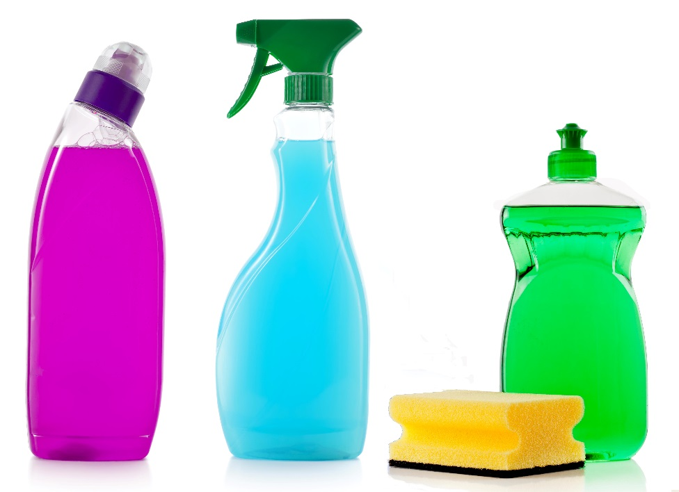
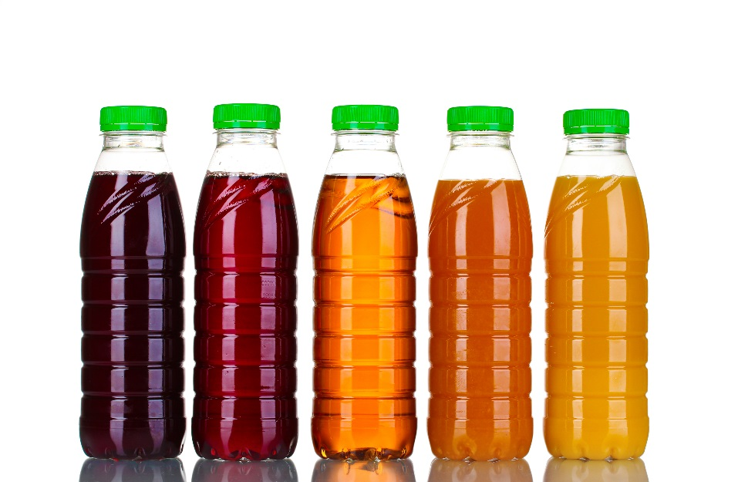
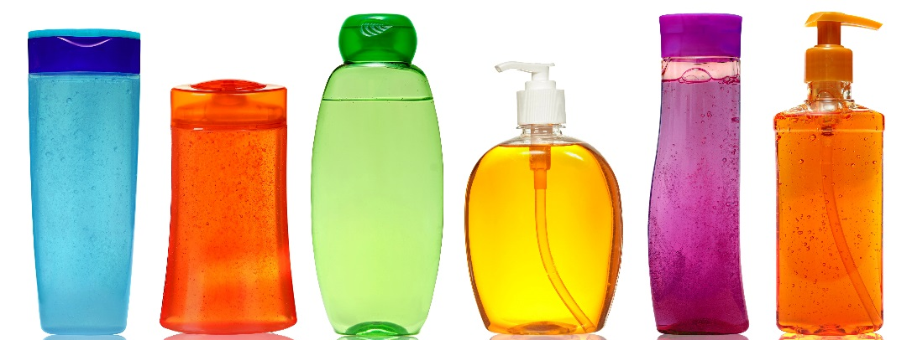
UV Protection in Clear PET bottles
Protecting content from harmful UV light
Allowing extended shelf life
Ensuring consistent brand image
Reducing formulation complexity
/29

Slide 29
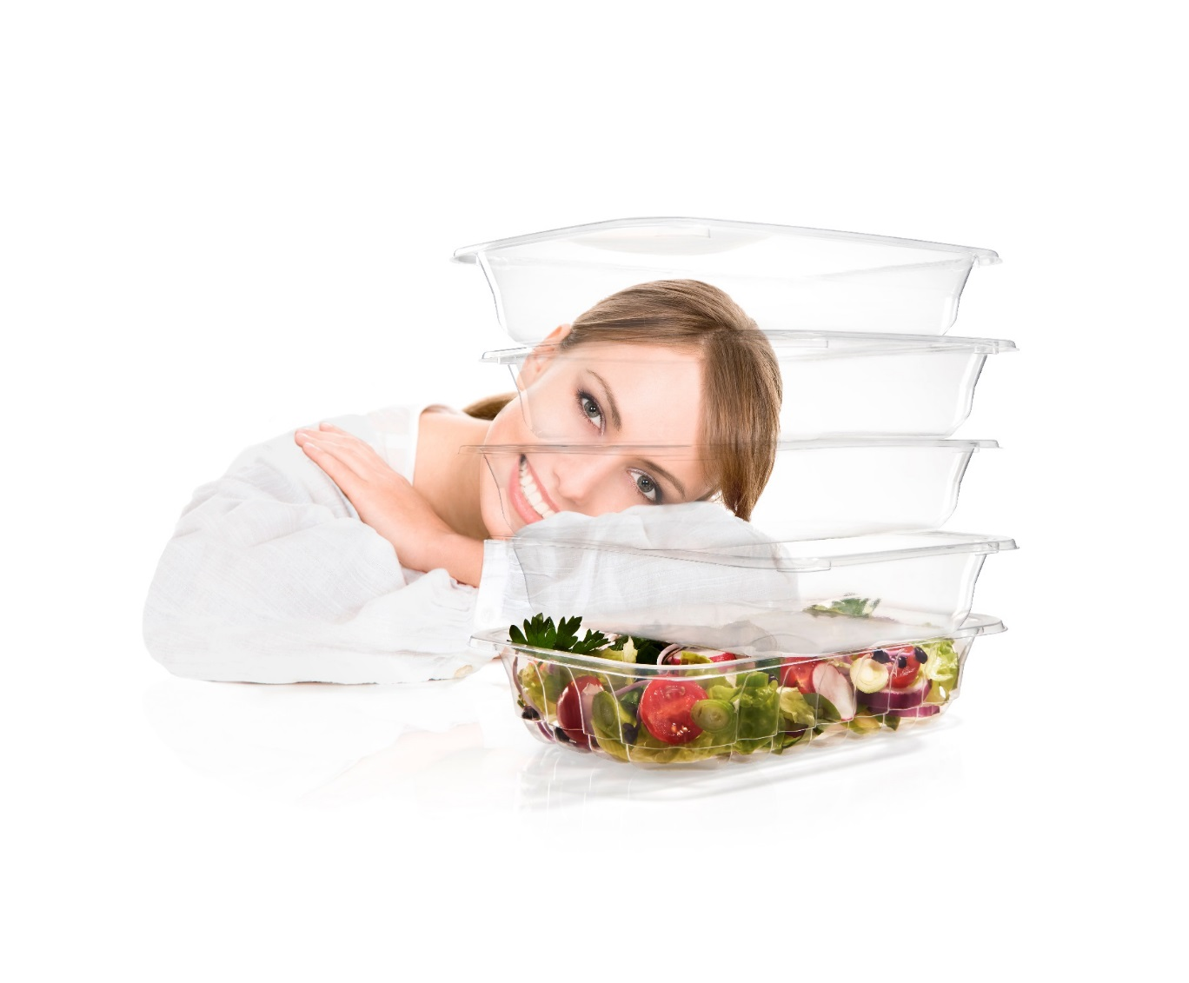
CREATING INNOVATIVE SOLUTIONS. TOGETHER
Ruben Subira
T +34 93 4972365 / C +34 669893566
ruben.subira@milliken.com

