Slide 1
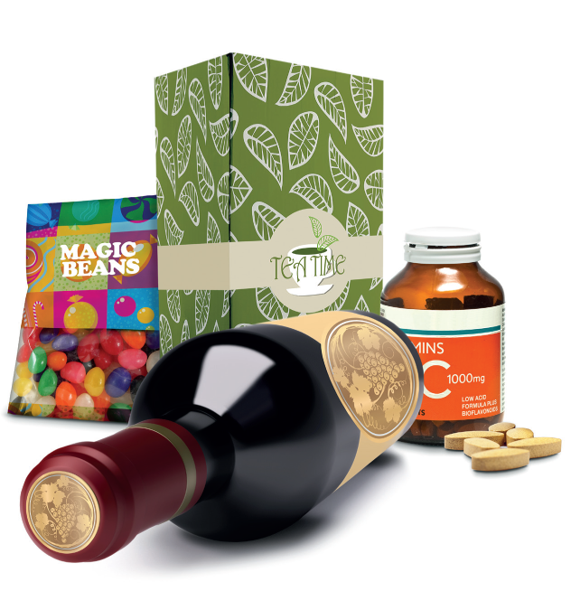
ENRGIZE … your brand
Andrej Petkovic
Professional Printing Solutions Adriatic
www.pps-adriatic.com

Slide 2
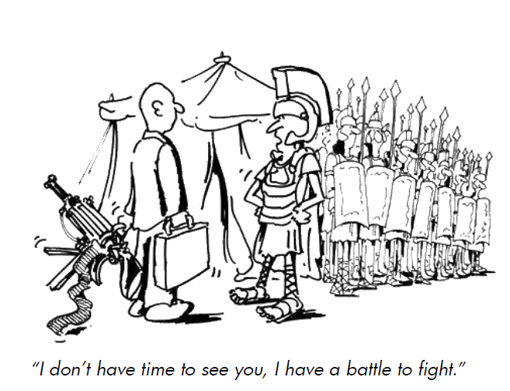

Slide 3
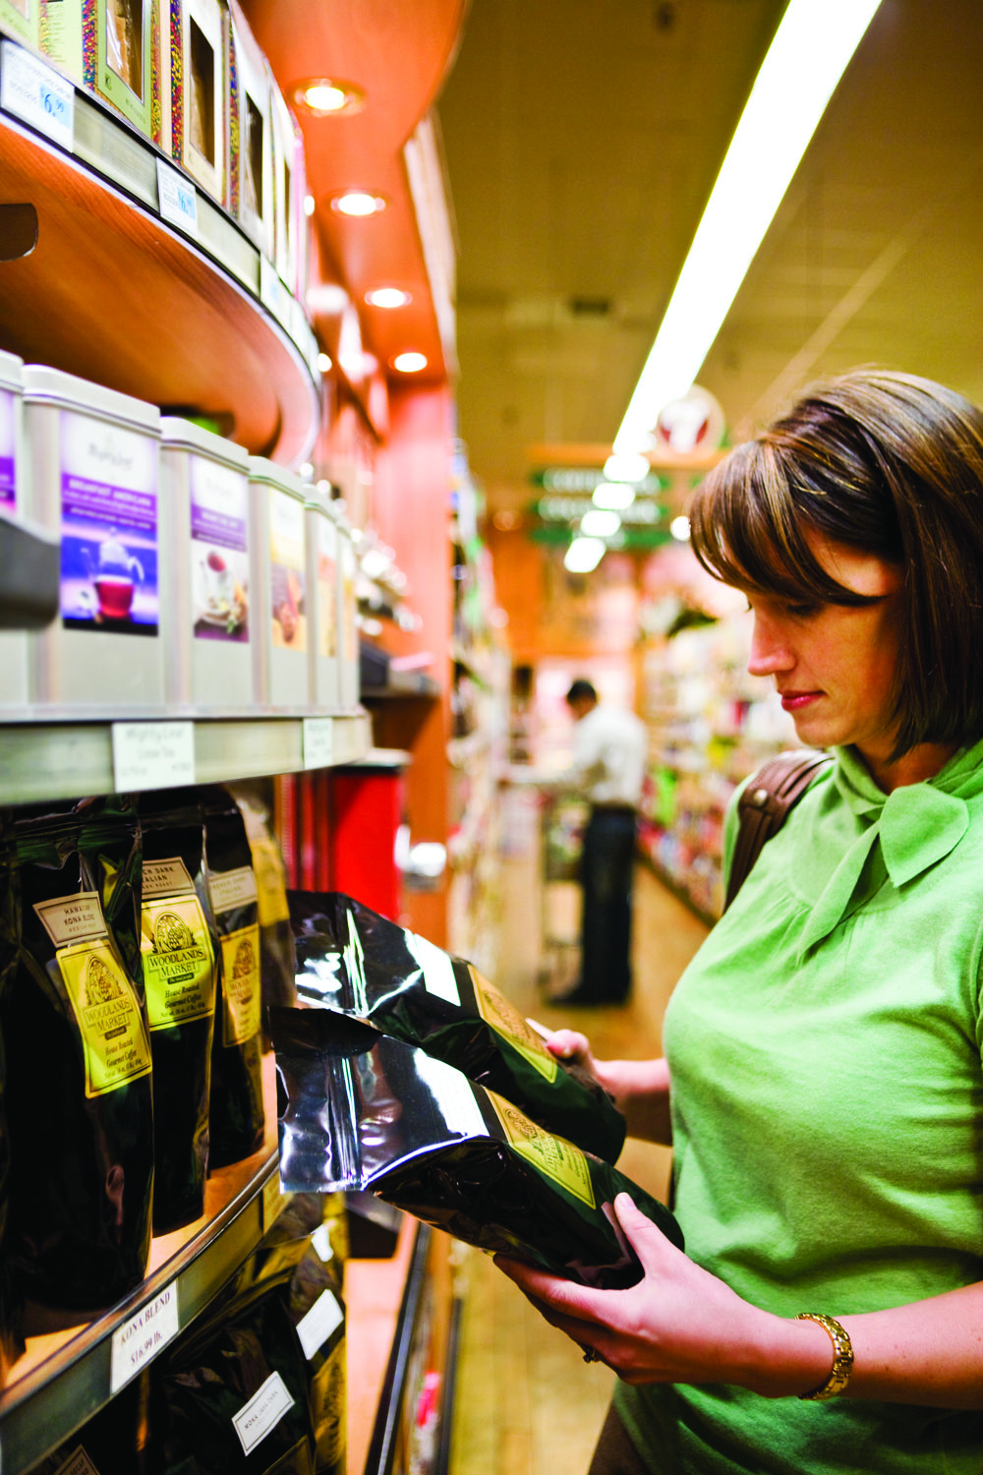
The shelves are our battle grounds for customers …
labels and packaging our best salesmen….

Slide 4
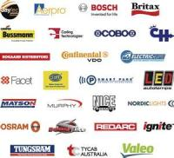
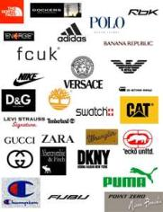
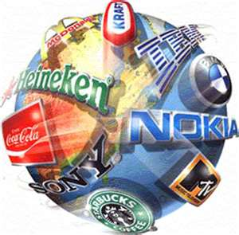


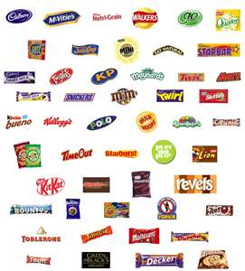
T
Thousands of brands to choose from
They all want to differenciate
from each other
consumers
Thousands of brands trying to attract
consumer’s attention

Slide 5
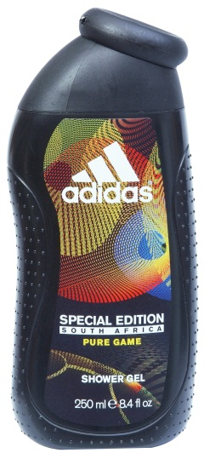
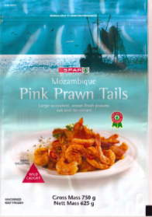
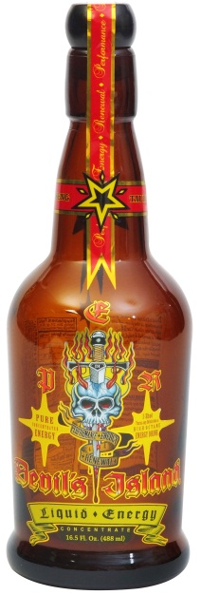
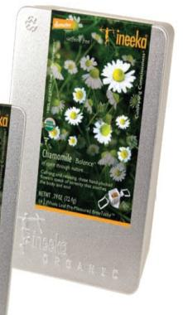
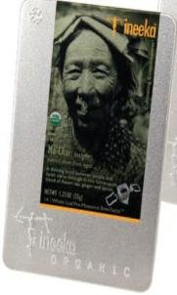
Master Trends
Market is growing….
Print runs are getting shorter…
But the number of Sku’s not..
Speed of response is a key factor
Quality behind compromise
On demand printing is a must
Green is good
5
Notes:
The challenge was to achieve the black circle watermark
effect extending from the Pomology logo. To achieve this
watermark look, we utilized a white underlay and black
overlay. The customer was very happy that we were able
to achieve this look digitally, without having to pay for
plates and higher label cost for a short-run order. We
were able to provide Bullwater Health & Fitness with press
proofs so they could review whether their desired effect
was achieved.

Slide 6













New trend driven by digital technology:
Fully integrated customer experience
Brand owners integrate consumer experience across all possible touch points:
virtual and physical
Social Media/Blogs
Packaging
Signage
Web
Direct mail
Mobile
Email

Slide 7

Brand owner’s wishes:
Source :
= Addressed by Digital printing
(5 = Maximum)

Slide 8
Impact of digital printing for brand owners
Printing costs
Illustration of costs and revenues
No specific scale applied
Digital printing
impact
Product(s) more focused
Higher value for user
More revenue
Product promotion:
Market tests, versions,
targeted products, on demand
Costs reductions
in the supply chain
Supply chain
⬅ Costs - Revenues ➔
Generic product
Product Devel
Market Test
Logistics Devel
Handling
Distribution
Manufacturing
End Of Life
R&D
Sales
There is a limit to cost reduction, but no limit to added value !

Slide 9
Brand owners need digital printing
For product design decision
For supply chain efficiency improvement
For supply chain cost reduction, for waste reduction
For compatibility with today’s technologies
For the consumer interest
For printing
= Addressed by Digital printing

Slide 10

HP INDIGO INNOVATION
The SHIFT to digital is happening all around us…
Brand & Consumer relations are EVOLVING
It’s all about PERSONAL touch!
DIGITAL creates endless possibilities…

Slide 11
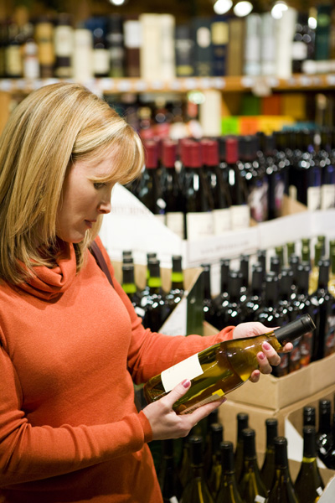
Responding to the market needs…
IS GOOD

Slide 12
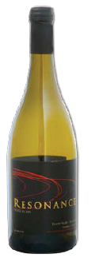
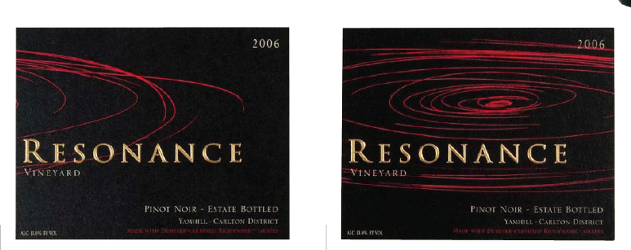
Shelf visual impact

Slide 13
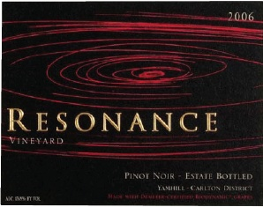
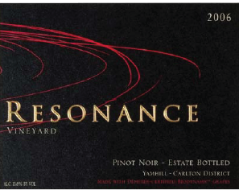
Shelf visual impact

Slide 14
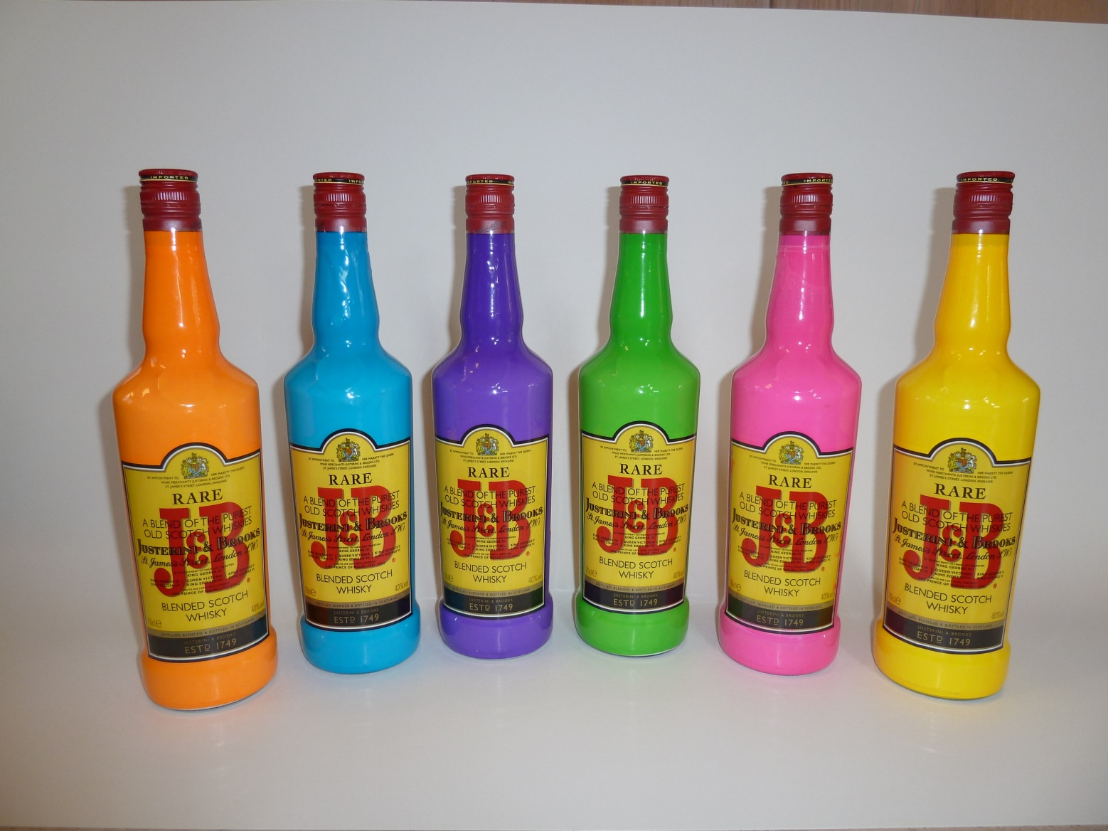
Shelf visual impact

Slide 15
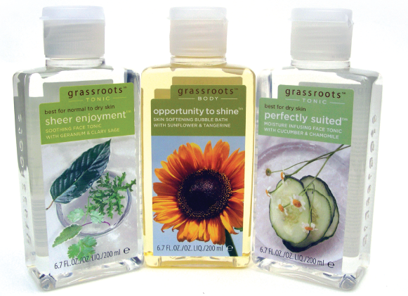
Grass Roots
Relevancy/Speed to market
Challenge
Produce 1.5 Million labels, 76 SKUs
Organic brand requiring frequent changes according to seasonality
Results
Prefect cloning of graphics language across regions and products
Gang multiple SKUs in the same run with the same cost
Reduce stocks and shorten TTM
Reduced waste

Slide 16
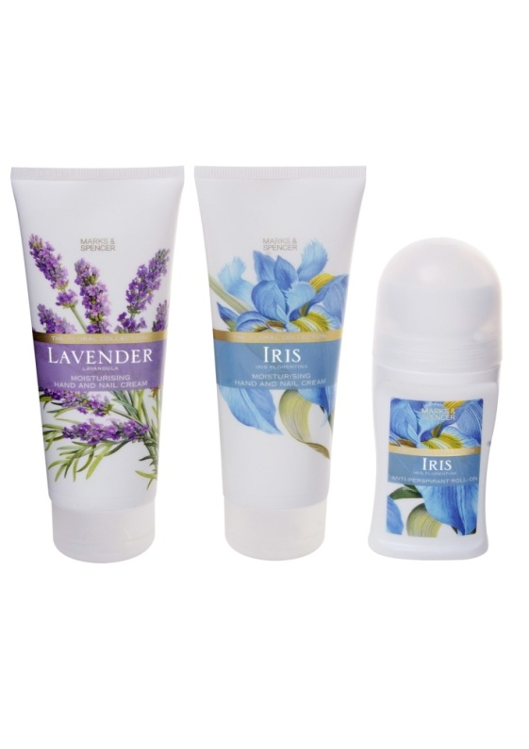
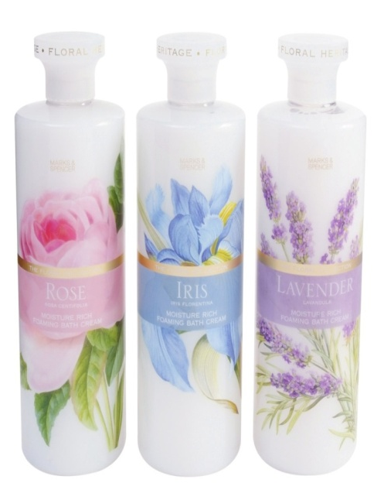
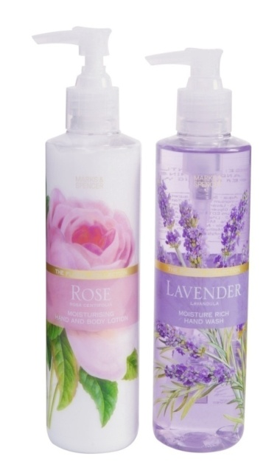
Marks & Spencer
Quality / Speed to Market
Challenge
SKU proliferation
Conventional Print quality unsatisfactory
Ability to design/proof/review design ahead of production at low cost
Solution
HP Indigo Digital Technology
Results
Entire Floral Collection transitioned to Digital
Volume > 2M labels/year for 63 SKU’s
Still Running, about to launch 4th redesign
Tripled order volume since launch

Slide 17








Involving consumers through attraction, relevancy and interaction increasing share for population related products

Slide 18

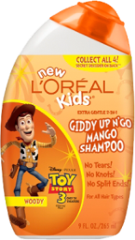
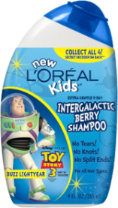
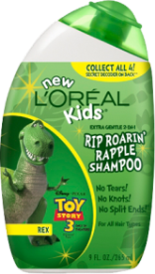
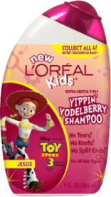
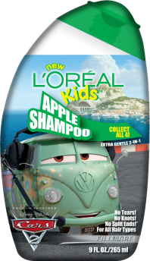
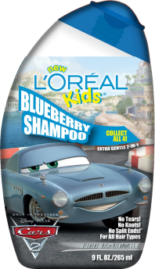
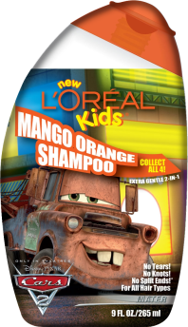
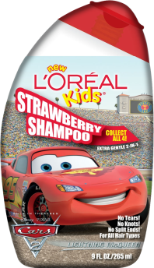
L’Oréal
Relevancy
Challenge
Conventional Print quality unsatisfactory
Print tool expense constrained program
Solution
HP Indigo Digital Technology
Results
Indigo registration optimized graphics
L'Oreal expanded program to 4 launches per year
Additional intent for variable imaging
“Our lead time was cut dramatically so that we achieved faster time to market.”
Notes:
Customer: Sancoa, USA. 4 x WS6000.
L’Oreal wanted a way to keep their packaging for kid’s shampoo updated and interesting for the kids.

Slide 19
Respond to the market needs…
IS GOOD
Interact with the consumer …
IS EVEN BETTER

Slide 20
One to One relationship
Example: “Culinary Twist”
A small manufacturer of gourmet sauces
Uses QR codes to feed online research to enhance product and influence sales in the aisle

Slide 21
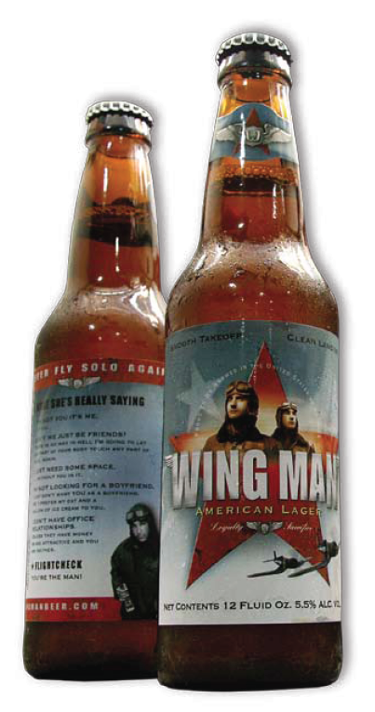

Wing Man Beer
Interaction
Challenge
Create differentiation
Make each bottle truly different
Appeal mainly to young adults
Solution
HP Indigo Digital Press
Results
High quality labels, each with different content
Different versions mixed along the web so each bottle in a pack is unique
“Do you like to dance? Well then could you go dance so I can talk to your friend?”
Notes:
Variable Data Application
The application required that each bottle have a different label during the bottling:
The text on the back label is variable:
Each bottle has a different “pickup line” on the labels and, a “flight check” to create a memorable time as the product is consumed.

Slide 22
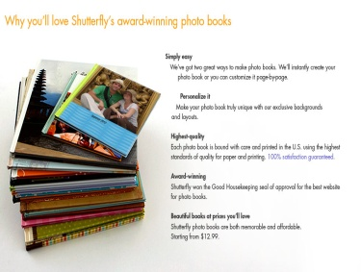

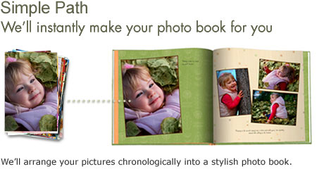

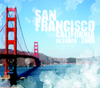
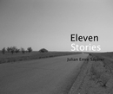

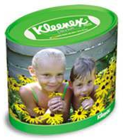
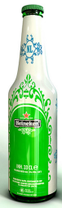


Drilling down to a customer of one!
Photoprint
Personalized photo books, etc
Publishing
Self Publishing
Packaging
Personalized packaging

Slide 23
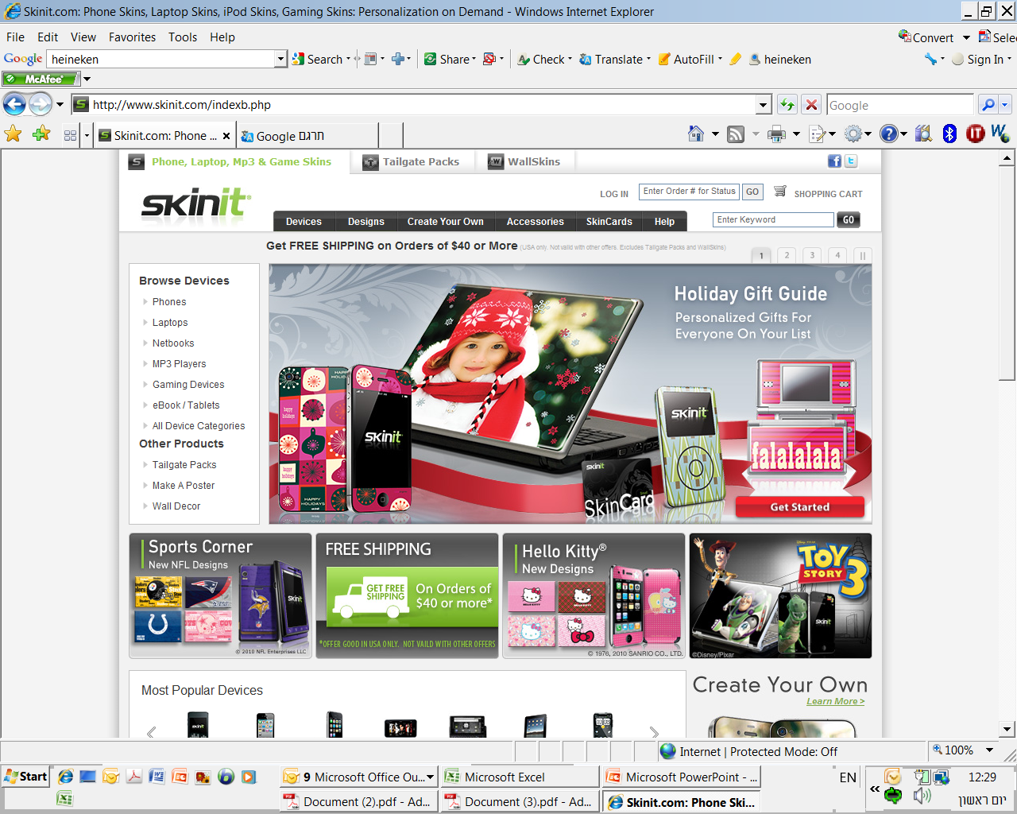
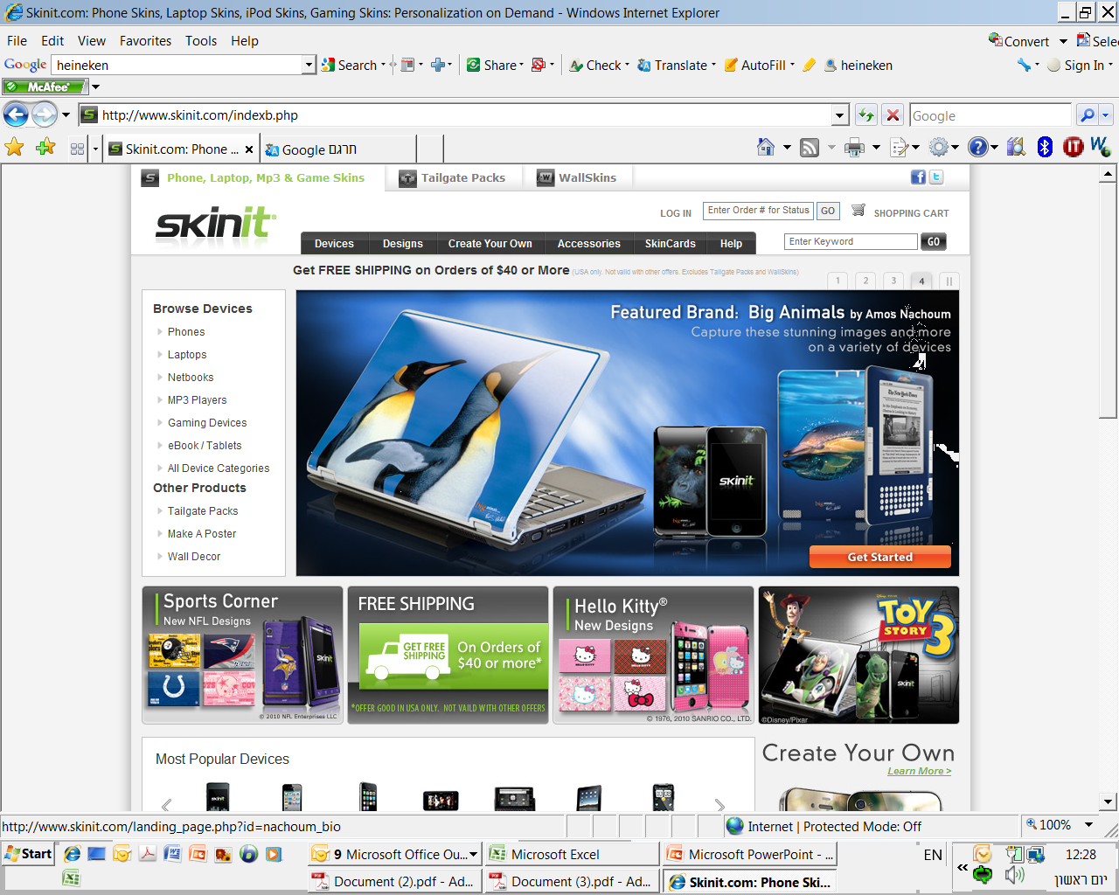
skinit.com

Slide 24
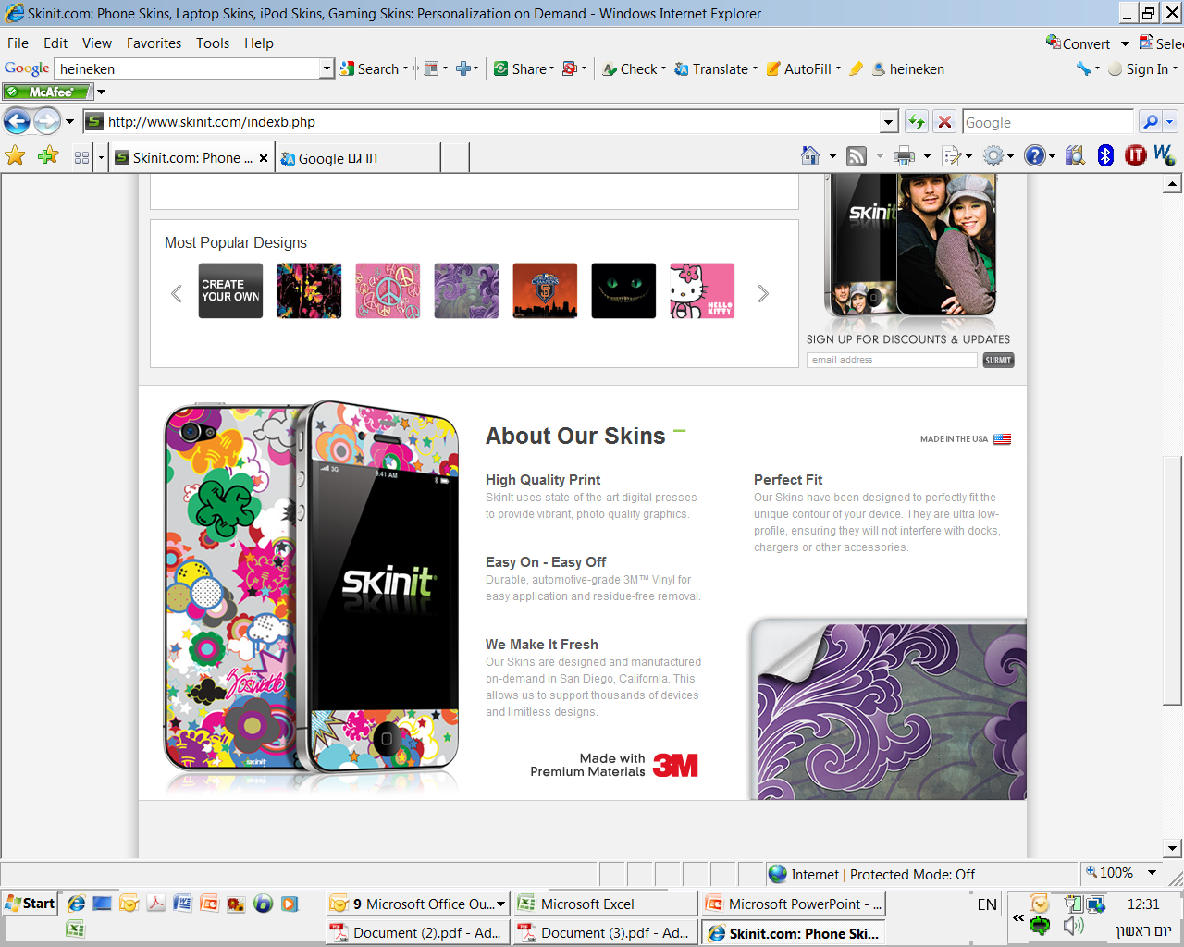

Slide 25
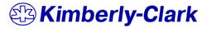
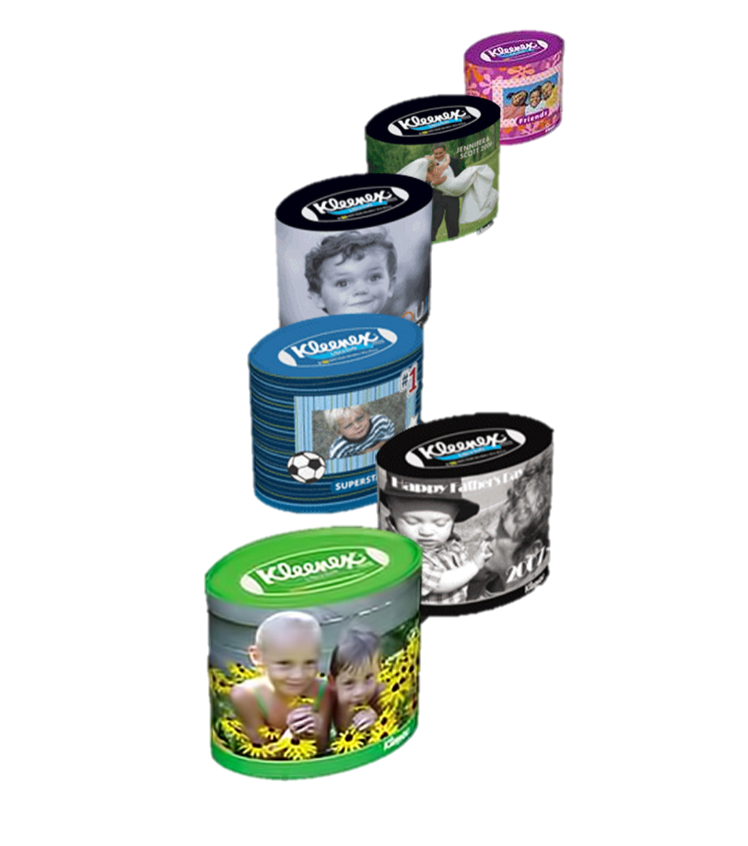
Kimberly-Clark
Loyalty Program - Engagement
My Kleenex
e-Commerce site that allows consumers to purchase personalized Kleenex boxes for any occasion
2010 – Kick off in the US
2011 – Expand to Europe (UK)
2012 – Launch in Israel

Slide 26
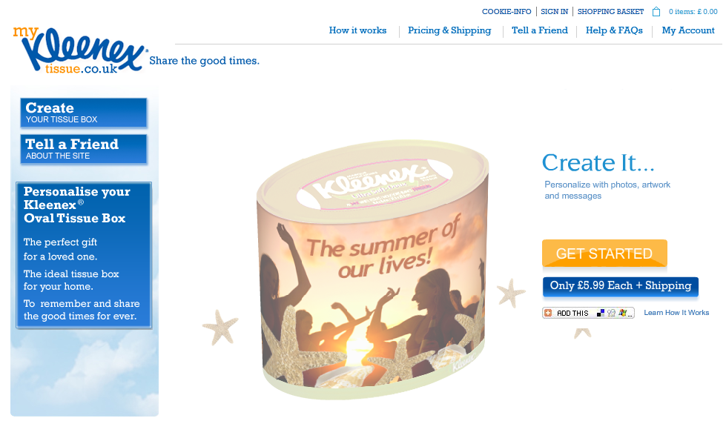

Slide 27

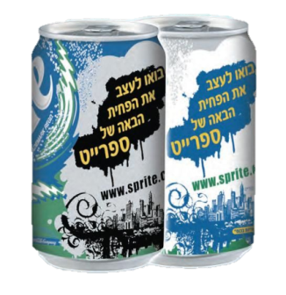
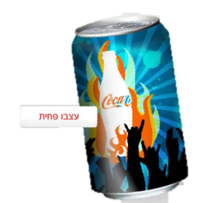
The Coca Cola Story
Global interaction with a local touch
2008 – design your sprite (Israel)
  Design contest with more than 100,000 submitted designs
  400 designs were printed in a limited edition
2010 – My coca cola (Israel)
  Design your own coke online
2011 – share a coke with (Australia)
  Mass customized cans and bottles on supermarket shelves (50 most common names)
  2011 – design your sprite (Brazil)
  Repeat of the 2008 design contest

Slide 28
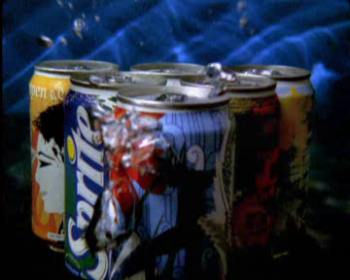
AND THIS IS HOW THEY Promoted IT…

Slide 29
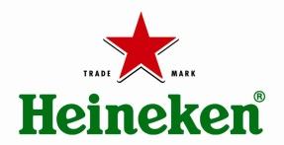
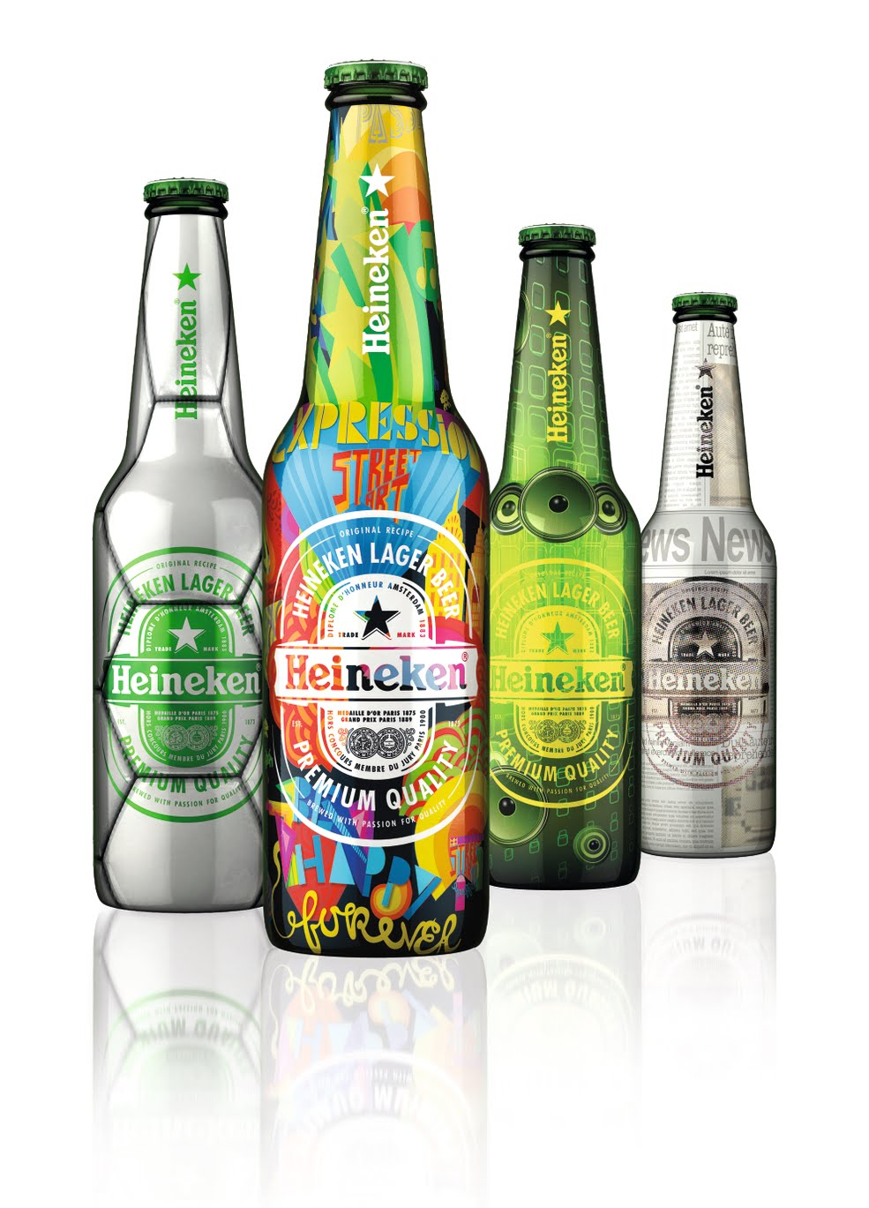
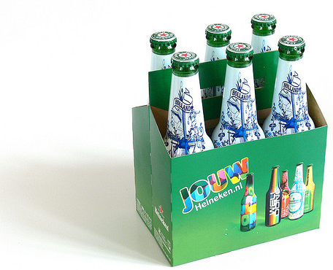
Heineken
Interaction
Your Heineken — demographic program through personalization
2009 began pilot in Netherlands
2010 expansion to Ireland and Spain
2011 expansion to Switzerland, Italy, Greece, Austria, Mexico & Chile

Slide 30
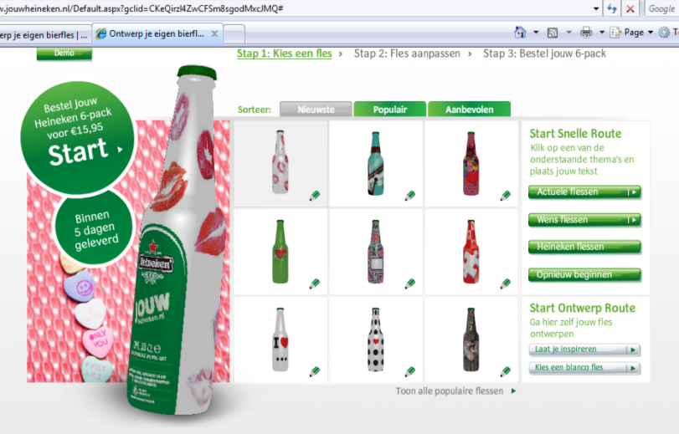

15.95 Euro

Slide 31

AND THIS IS HOW THEY PROMOTED IT…

Slide 32

Welcome to augmented reality

Slide 33

End user interacts
Also After purchaising

Slide 34



Slide 35


Slide 36








HP INDIGO
VERSATILITY
Self adhesive prime labels
Shrink sleeves
Flexible packaging
Flexible tubes
Folding cartons
Wine capsulses
Industrial labels
Tags
36

Slide 37

Thank you !

