Slide 1
&
Creativity
WITH
Technology
How to grow in a flat economy.

Slide 2
These brands has
NO factory

Slide 3
This brand has
NO factory
but .....KNOWLEDGE!

Slide 4
WE are European…
CREATIVITY with TECHNOLOGY

Slide 5
Wide format – Digital Printing
European Market trend
18 years of amazing grow in Digital Market
From 1990
To 2007
22,6 %
Per year
2008
2009
2010
2011
2012
2013
2014
2015
2,8 %
1,8 %
2,2 %
2,6 %
1,4 %
+ 1,8 %
+ 2,4 %
+2,8 %
Sources:
PIE (Plastic Information Europe)
AC Nielsen
IT Strategy
Internal elaboration to have an overall view of the Market.
Estimated

Slide 6
European Market trend
Il Market Share
 | Hardware | Inks | Rolls | sheet | Roll-up Pop-up display Alu profiles
2000 | 29 % | 23 % | 38 % | 6 % | 4 %
2007 | 25 % | 23 % | 39 % | 6 % | 7 %
2010 | 21 % | 23 % | 39 % | 9 % | 8 %
2012 | 15 % | 23 % | 41 % | 11 % | 10 %
2013 | 16,5 % | 23,5 % | 40,5 % | 10 % | 9,5 %
2014 | 17 % | 21 % | 42 % | 11 % | 9 %
Next table

Slide 7
How roll media are evolving
Media | 2007 | 2012 | 2012 | 2014
 | 0,8 % | 2,8 % | 3,5 % | 4,2 %
 | 2,8 % | 3,3 % | 3,5 % | 4,6 %
 | 2,4 % | 3,3 % | 3,5 % | 3,7 %
 | 3,6 % | 4,8 % | 5,5 % | 6,7 %
 | 0,4 % | 1,2 % | 2,5 % | 4,1 %
INTERIOR DECOR
WINDOW GRAPHICS
SPECIALITIES
FULL PLASTIC
19,1
9,2
TEXTILE
+107%
in the last 5yrs
MAGNET & Steel Film
 | 23 % | 24 % | 24 % | 24 %
 | 29 % | 24 % | 22,5 % | 19 %
 | 38 % | 36 % | 35 % | 29,8 %
SELF-ADHESIVES
COMMODITIES
PAPER
BANNER
-23% in 2014
90%
72,8%
-20%

Slide 8
Wide format – Digital Printing
European Market trend
 | Share | Margin | Applications | Trend
Comodities | 82% |  | OUTdoor | -20% yearly
Specialties | 18% |  | INdoor | +107%

Slide 9
The key of success
in «crise» period
So, what to do?
WIDENING
THE IDEAS and APPLICATIONS
1 idea
10 technologies
100 applications

Slide 10
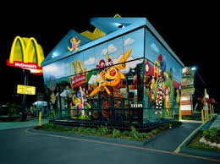
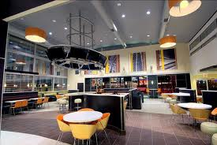
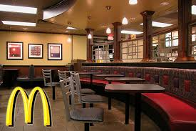
Wide format – Digital Printing
European Market trend
effect

Slide 11
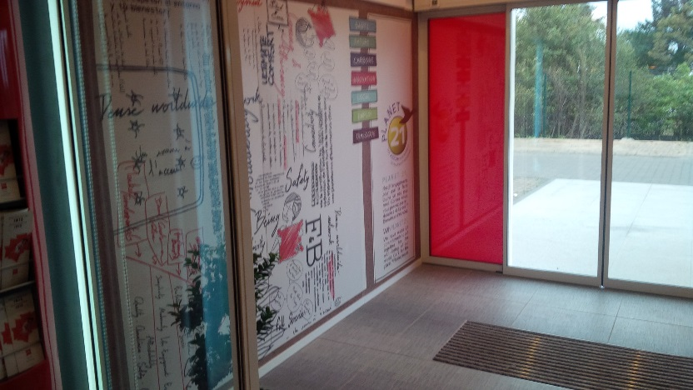
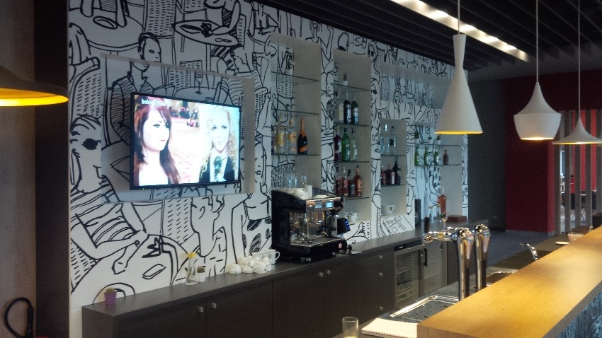
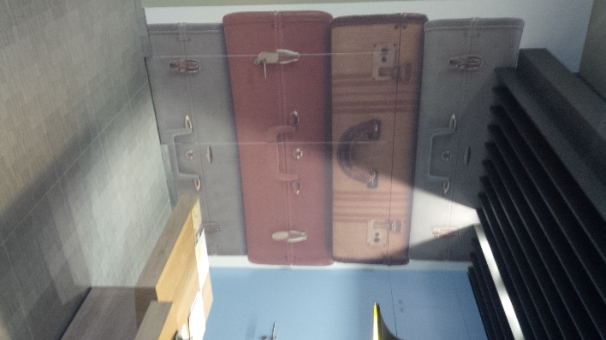
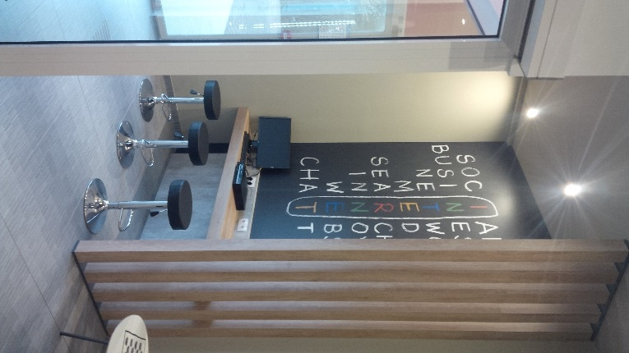
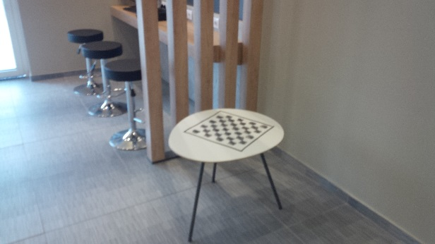
Wide format – Digital Printing
European Market trend
effect

Slide 12
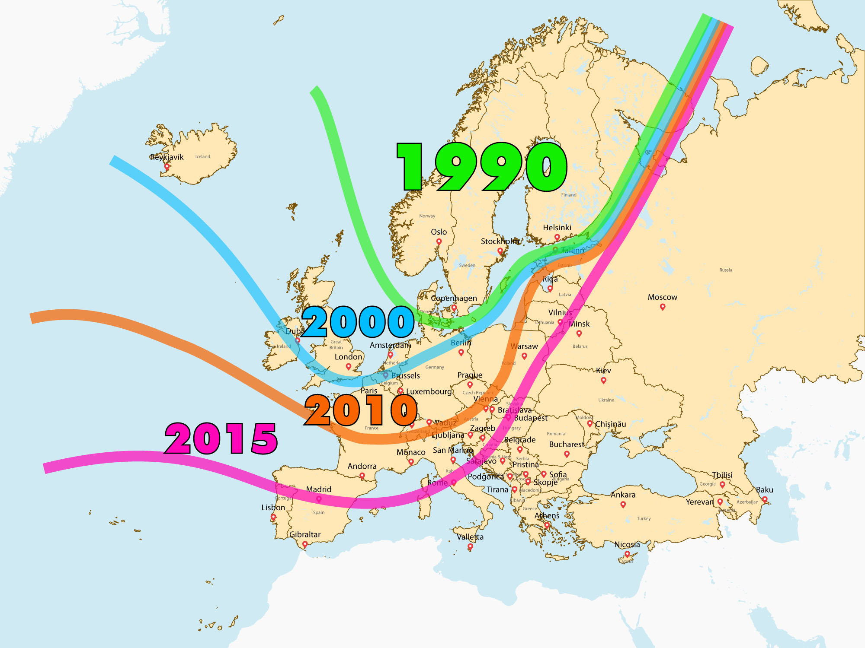
PROGRESS of
GREEN
And
SOUSTINABILITY

Slide 13
Growing in a flat economy
This is what the marketing guru say…

Slide 14
The World of Media
What’s around the corner…
CREATIVITY with TECHNOLOGY
NIGHT & DAY
WINDOW GRAPHICS:
WINDOW GRAPHICS:
Double Way Vision DWV® Image
THE MAGNETIC WORLD OF MAGNET
+
BANNERING EVOLUTION:
&
ROLL-UP & POP-UP :
&

Slide 15
CREATIVITY with TECHNOLOGY

Slide 16
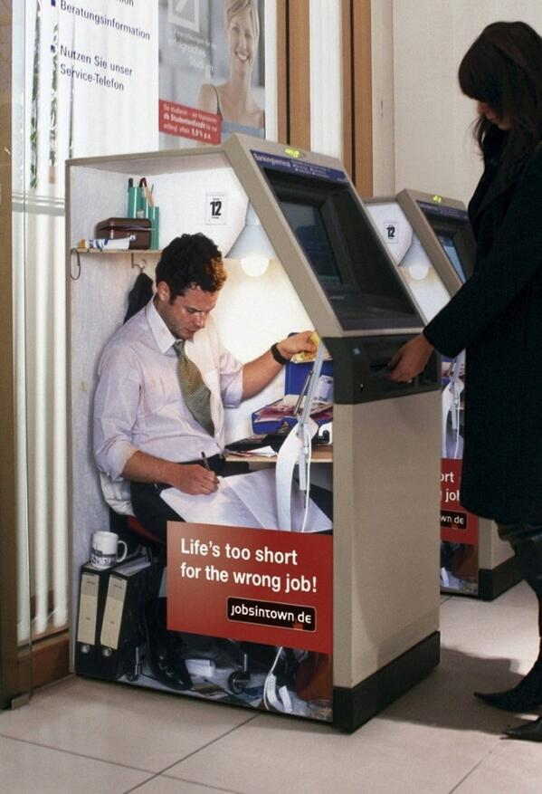
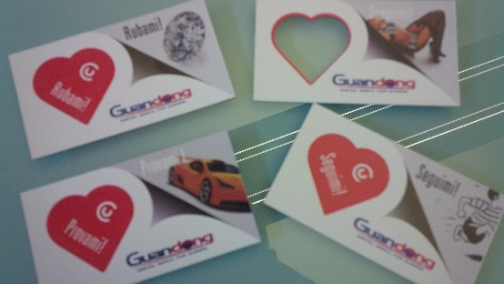
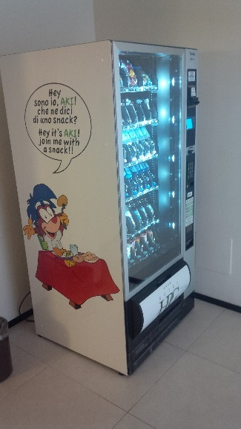
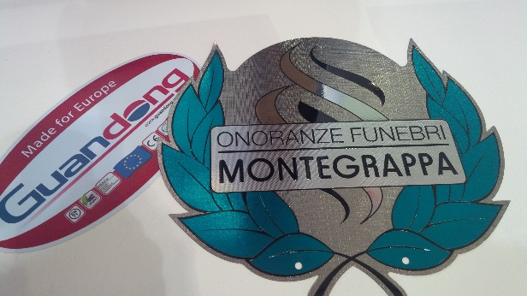
CREATIVITY with TECHNOLOGY

Slide 17
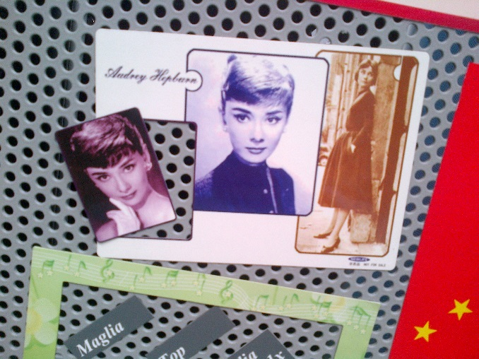
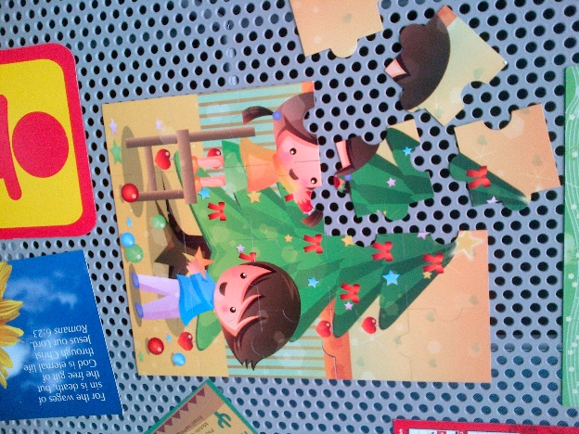
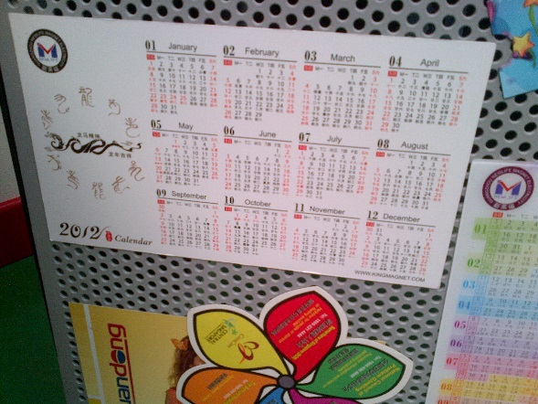
CREATIVITY with TECHNOLOGY

Slide 18
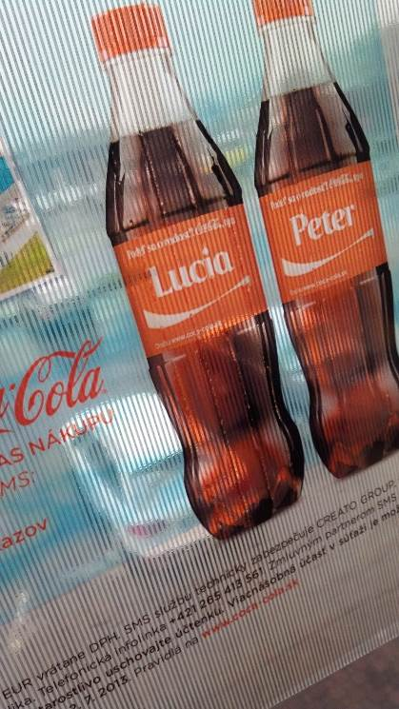
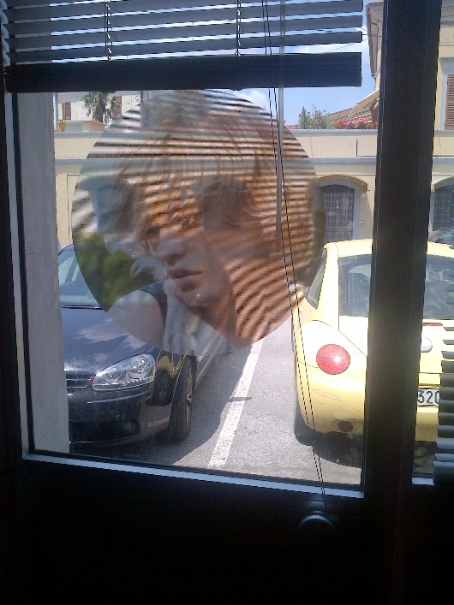
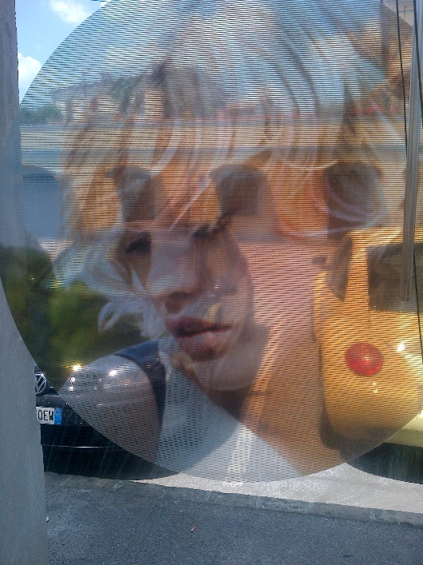
Double Way Vision DWV
CREATIVITY with TECHNOLOGY

Slide 19
NIGHT & DAY
CREATIVITY with TECHNOLOGY

Slide 20
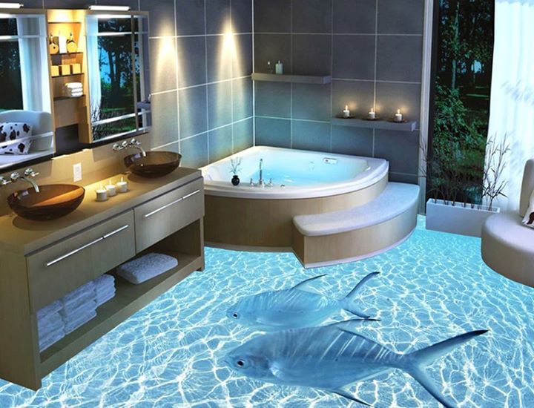
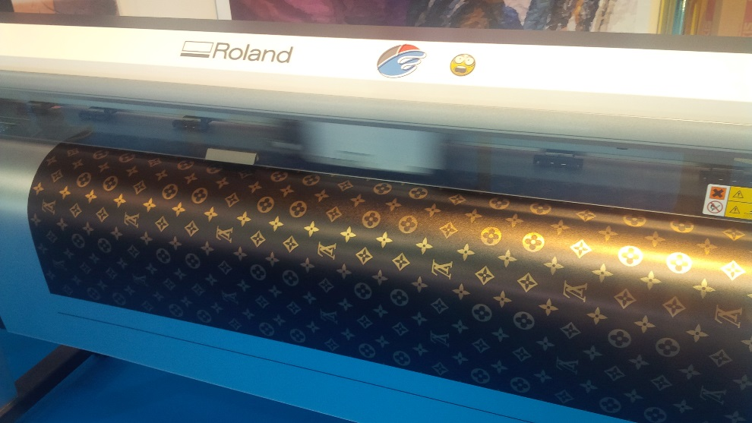
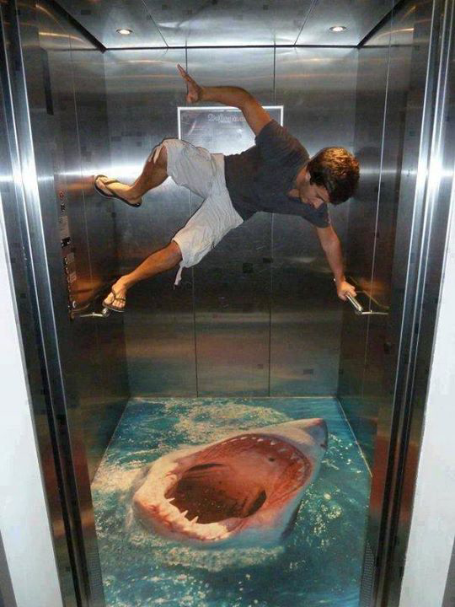
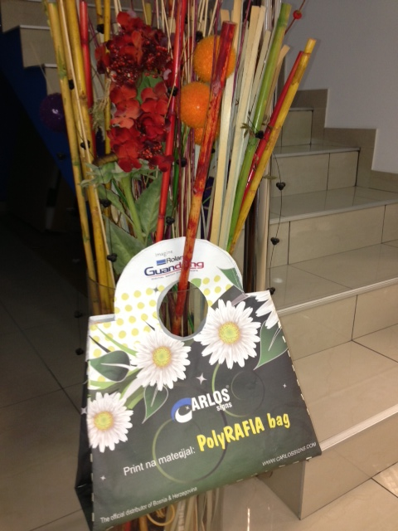
CREATIVITY with TECHNOLOGY

Slide 21
NOW it’s Your moment
CREATIVITY with TECHNOLOGY

Slide 22
The…
…be with You!!!
…see You in

