Slide 1
Canon & Océ: Winning combination
Rob Koenen & Oleksandr Makovsky, Canon CEE
Notes:
Environment did not come out of the Insight report as a key issues. But in working with CRDs over the past few years and our own in depth interviews in 20+ CRD’s across Europe, we have seen increasing interest and attention to it, driven by CSR.
Therefore we are developing modules around it.

Slide 2
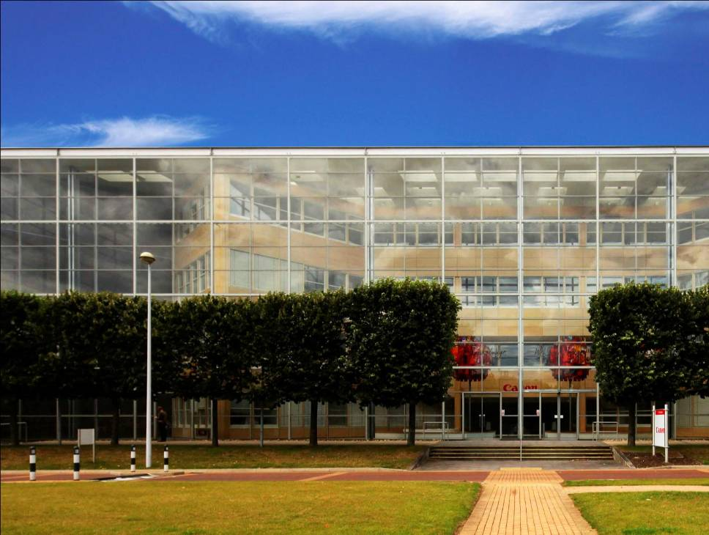
Why Canon? (including who is)
Canon: A long term partner
Why Partner with Canon
Canon has 0% borrowing and a long term focus on sustainable growth
In 2010, Canon invested 9% of total revenue in Research & Development
The acquisition of Océ is ensuring that Canon can deliver an even broader portfolio of products and solutions to our Partners

Slide 3
How Canon reaches the customer

Slide 4
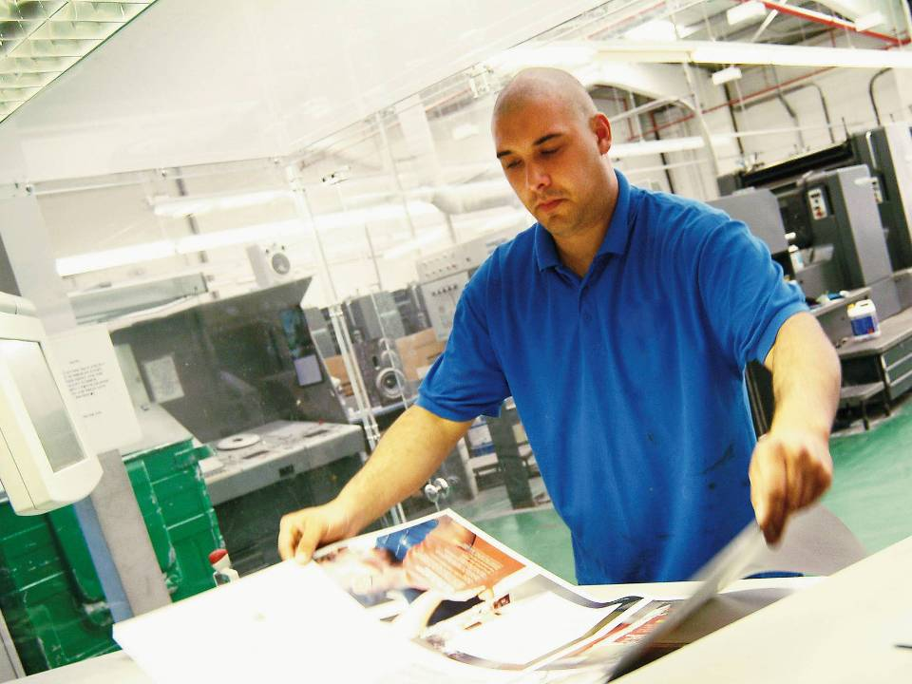
How Canon reaches the customer
Right solution
=
Share market information with customers
Explain / discuss market movement / Trends
+
Offer right business support
Business solution to support customer’s decission
Notes:
Success in commercial print
Created the insight report – digital printing directions – for drupa 2008
Helping customers to make INFORMED BUSINESS DECISIONS

Slide 5
Canon & Océ: a winning combination
Canon & Oce together
One-stop-supplier
Trends and appliactaions
Right solutions / services
Growth path and ROI

Slide 6
Canon & Océ: a winning combination
Canon & Oce together
One-stop-supplier
Trends and applications
Right solutions / services
Growth path and ROI

Slide 7
Canon & Océ: a winning combination
HV
Océ
TDS
Production
Océ
DGS
MV
LV
Canon
LFP
Work
group
Convenience
Personal
CAD: 2D
Imposition
Proofing
CAD: 3D
Disposable
POP
GIS
Business Graphics
Consumer Graphics
Display
Graphics
Color
Proofing

Slide 8
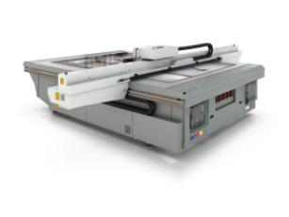
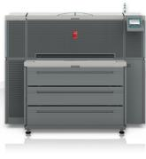
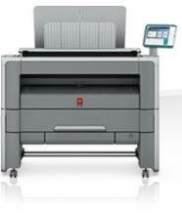
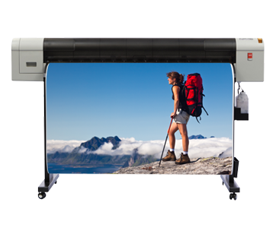
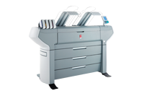
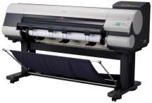
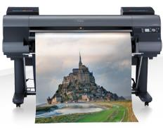
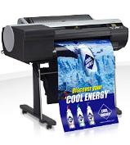
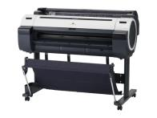
Canon & Océ: a winning combination
HV
Production
MV
LV
Work
group
Convenience
Personal
CAD: 2D
Imposition
Proofing
CAD: 3D
Disposable
POP
GIS
Business Graphics
Consumer Graphics
Display
Graphics
Color
Proofing

Slide 9
Canon & Océ: a winning combination
Canon & Oce together
One-stop-supplier
Trends and applications
Right solutions / services
Growth path and ROI

Slide 10
Trends in wide format printing
From central reprographics to local printing
From Black & White to color printing
Growth in GIS printing (= color)
“Power” to the professional end users & IT
“Green” and sustainability
Interest into wide format from cut commercial printing companies (cut sheet)

Slide 11
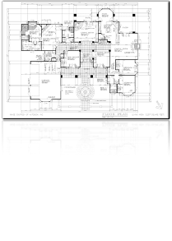
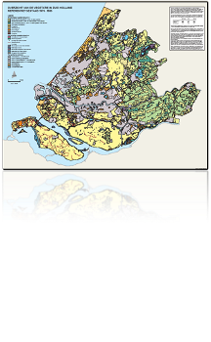
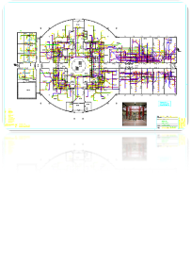
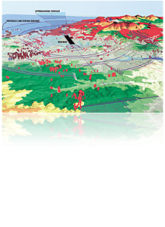
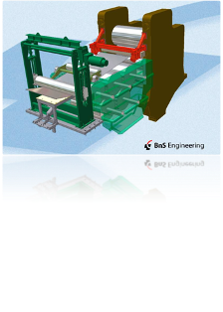
CAD applications
2D CAD
GIS
PlotWave
imagePROGRAF
3D CAD & renderings

Slide 12
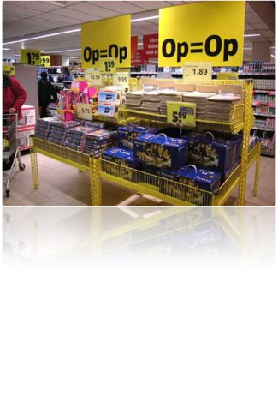
Point of Sales / Purchase
ColorWave
imagePROGRAF
12 of 30

Slide 13
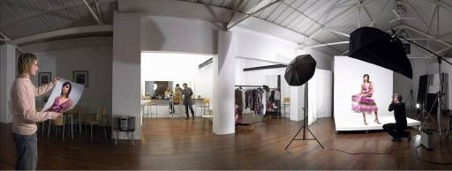
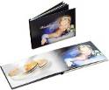
Photography & Fine Art
imagePROGRAF

Slide 14
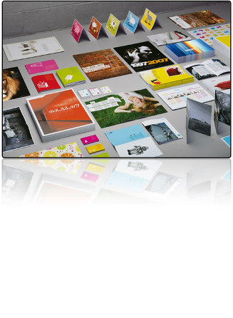
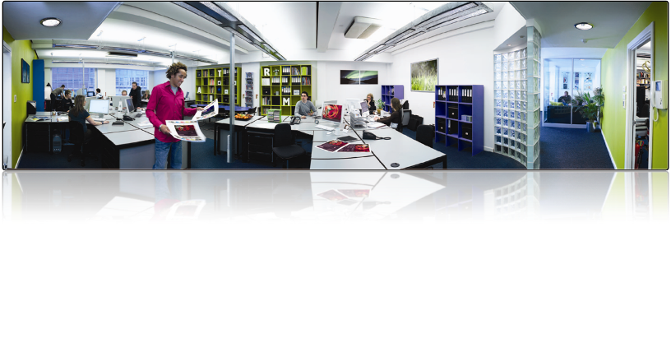
Proofing
imagePROGRAF
Arizona
14 of 30

Slide 15
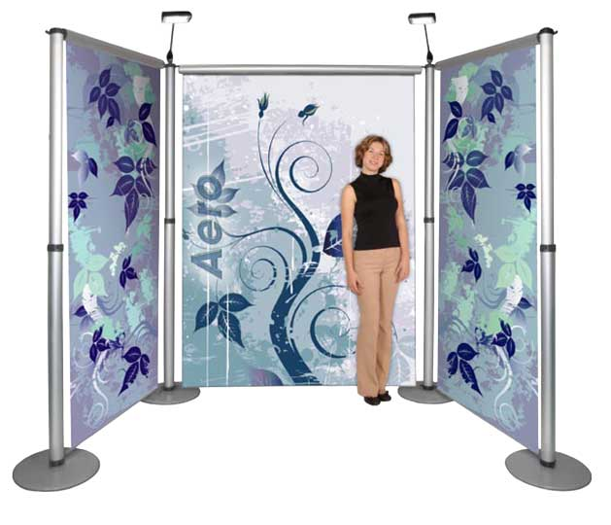
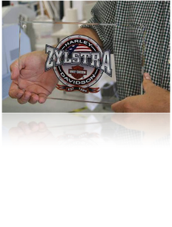
Display Graphics
Value added applications
Higher margins
Distinctive character
Printing directly on substrate
Customization
More added value
Higher impact
Transition (analogue) offset- and screen printing to digital
Cost effectively low production runs
More flexibility and possibilities
Shorter lead times
Arizona
Notes:
What are the trends in the market?
We’ve tried to group them into three.
The first is Value added applications.
End-users are searching to make more money and a relative simple method is to use the opportunity of UV curable flatbed printing directly on the media, which in the saves costs, comparing with the traditional way of printing on self-adhesive vinyl and mounting this on the media, but above all it gives a distinctive character by using the media underground itself. For example printing a piece of signage/award on plexi glass which is showed on the image of what we’ve seen earlier printing directly on ceiling tiles.
The second trend is customization
I would say that this is a common trend in the world. People are using the opportunities to distinguish themselves by driving their own tuned, colorful cars.
Can you imagine how Sir Henry Ford would have respond to this if he would be still alive. (statement 1909). In the end also here it’s about added value and create a higher impact.
And the last but not the least is the transition from analogue offset and screen printing to digital.
As I already briefly mentioned, these segments are still very traditional oriented, they own the volumes and can and will benefit from the advantages from digital printing.\
INTERACTION: Any major trends we miss in your opinion?
Let’s move to the facts and the figures, because they in the end don’t lie. By the way, these figures are used and studied in detail with the objective to predict the future and this is obviously very difficult. Having said that, my objective in this is not to tire you with all kind of figures, but to help you understanding our product development and market focus. In the end of the day. Market Intelligence is all about preventing making big mistakes.

Slide 16
Canon & Océ: a winning combination
Canon & Oce together
One-stop-supplier
Trends and applications
Right solutions / services
Growth path and ROI

Slide 17
Add software
PA
uniFLOW
Thrive
ProCut
Click base
Canon & Océ: a winning combination
HV
Production
MV
LV
Work
group
Convenience
Personal
CAD: 2D
Imposition
Proofing
CAD: 3D
Disposable
POP
GIS
Business Graphics
Consumer Graphics
Display
Graphics
Color
Proofing

Slide 18
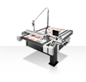
Canon & Océ: a winning combination
HV
Production
MV
Oce ProCut
LV
Work
group
Convenience
Total Service Care
Personal
CAD: 2D
Imposition
Proofing
CAD: 3D
Disposable
POP
GIS
Business Graphics
Consumer Graphics
Display
Graphics
Color
Proofing

Slide 19
Canon & Océ: a winning combination
Canon & Oce together
One-stop-supplier
Trends and applications
Right solutions / services
Growth path and ROI

Slide 20
Canon & Océ: a winning combination
Product portfolio: star from small business and then grow
Refubrishing/buy-back
offer different technologies – different applications for the whole market
=
Growth path and ROI

Slide 21
Canon & Océ: a winning combination
Following customers
who already use
Canon & Oce
Notes:
AS YOU CAN SEE FROM THE TABLE CUSTOMER SATISFACTION AMONGST USERS OF WEB TO PRINT IS MUCH HIGHER THAN THOSE SENDING WORK TO A PRINTROOM WHICH HAS NO WEB TO PRINT.

Slide 22
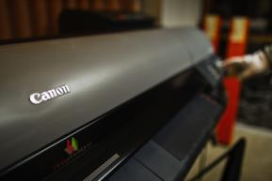
Foto Jug - Private photo studio
Photo studio in the heart of Plitvice Lakes National Park
Internationally renowned landscape photographer
High quality artistic photo products:
Private collections
Exhibitions, competitions
Resale
Notes:
TOMS has been active in the mining industry for 17 years, providing a wide range of services for big projects in mineral resources development, both in Russia and abroad. The services vary from geological modelling and resources calculation to production and construction of a modern, efficient plant.
How to cope with an increasing flow of orders?
For the company TOMS, as well as for other advanced engineering,
construction and architectural companies, the Océ PlotWave 300 has become an indispensable tool that combines ease of use, low power consumption and noise, compact dimensions and ability to
withstand heavy loads.

Slide 23
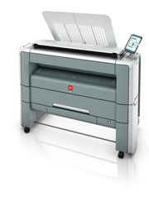
The golden print standard
TOMS is active in the mining industry, providing a wide range of services for big projects in mineral resources development, both in Russia and abroad. The services vary from geological modeling and resources calculation to production and construction of a modern, efficient plant.
Customer considerations:
ease of use
low power consumption and noise
compact dimensions and
ability to cope with heavy loads
Notes:
TOMS has been active in the mining industry for 17 years, providing a wide range of services for big projects in mineral resources development, both in Russia and abroad. The services vary from geological modelling and resources calculation to production and construction of a modern, efficient plant.
How to cope with an increasing flow of orders?
For the company TOMS, as well as for other advanced engineering,
construction and architectural companies, the Océ PlotWave 300 has become an indispensable tool that combines ease of use, low power consumption and noise, compact dimensions and ability to
withstand heavy loads.

Slide 24
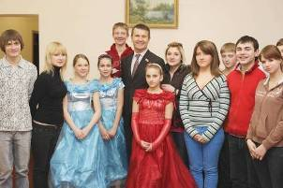
Pleasure of life for ‘Children of Chernobyl’
“Children of Chernobyl” organization provides children of victims social support and creative development.
About 300 children have a chance to develop their own design projects, work in children’s photo studios or other creative projects
The Océ ColorWave 600 prints all their design projects from wall paper to photo pictures and banners.
Notes:
The public organization «Children of Chernobyl» helps children of victims of the Chernobyl disaster.
«Children of Chernobyl» organization provides children with medicine and other necessary support, but also in social adaptation and creative development.

Slide 25
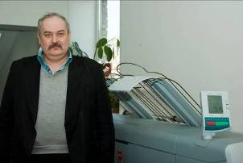
GIS Work horse in urban Moscow
The “Research and Design Institute NIiPI Genplan takes care of urban planning of construction areas, spatial planning and cartography.
Printing project documentation is a key activity in these processes as it allows to visualize the results of their projects.
Growing demands, print quality and productivity were decisive factors to choose the Océ ColorWave 600
Notes:
The “Research and Design Institute of the General Plan of Moscow” (NIiPI Genplan) takes care of urban planning of construction areas, spatial planning and cartography. Printing project documentation is a key activity in these processes as it allows to visualize the results of their projects.
The printing equipment that NIiPI had installed could no longer fulfill the growing demands of the organization. Print quality and productivity were two factors that needed to improve together with reliability, because of the increasing work load and the frequency with which the media needed to be changed. The Océ ColorWave 600 fitted perfectly in this picture.

Slide 26
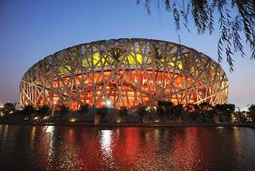
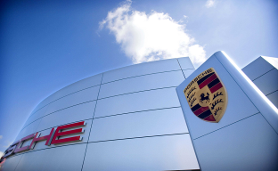
Building the world
Up to - for example:
Beijing Olympics Stadium
Soccer City stadium in South Africa
Nearly all major Automotive and Aerospace manufacturers print on Océ

Slide 27
JAM Fine Art Print
Fine Art Printer
Highlight Story:
Offering unique fine art web portal for photographers and artists
Supports colour managed workflow with accurate soft proofing for clients
Investment in two imagePROGRAF 8300 devices linked to web portal
Provides high quality output at optimal cost on wide variety of media

Slide 28
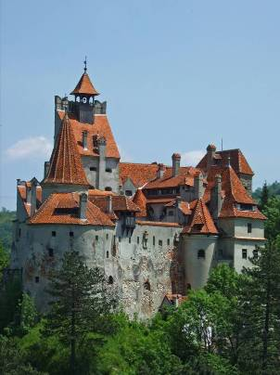
Registration all cadastral properties in Romania?
Océ is a leading provider of centralized color and black/white printing solutions in the governmental market
Main production gear:
13 x ColorWave 650

Slide 29
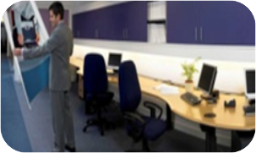
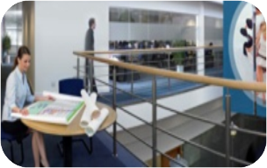
Mairie de Balleul
Town Council Print Facility
Canon is an approved supplier to the council run office and schools
Recent investment in imagePROGRAF 8000S to meet needs of both graphic design and technical drawing departments
Excellent support and advice from Canon, including local training on colour management
Helping to keep more work in-house making jobs quicker, easier and cost effective to produce

Slide 30
Customer Story – Retail market
Fast growing retail chain
Substantial Print Volume: 25k – 50k m2 per year with peak volumes
High pressure on meeting deadlines
Centralised production then distribute to shops
Straightforward DMU
IT & Operations
Single application: enables fast sales cycle

Slide 31
You’re in good company!

Slide 32
Thank you
Canon & Océ: your winning combination

