Slide 1


The graphic industry in times of change – make print and digital media coexist
March 2014
Beatrice Klose
INTERGRAF

Slide 2
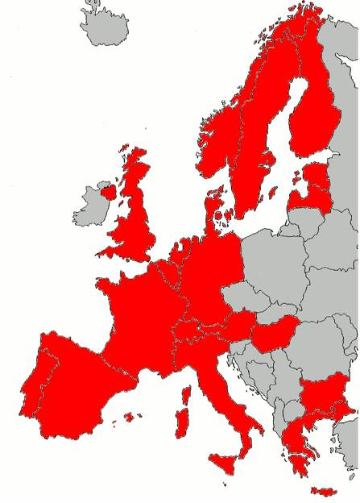
INTERGRAF
Federation for Print and Digital Communication
Avenue Louise 130A, BE - 1050 Brussels
23 member associations in 20 countries
2 Associate members
Secretariat and Member of the World Print & Communication Forum
EU 28 in 2011
118,000 companies
685,000 employees
88 billion EUR turnover
Notes:
Sector which is dominated by small and
micro companies
Largely focussed on domestic market
Dependant on advertising
Characterized by structural overcapacity
B. Klose

Slide 3
Why a European Association for print and digital communication?
Political Decisions are taken increasingly in Brussels
The European Commission works with European Associations who represent the industry and provide “industry consensus”
Monitoring and Influencing the decision making process
Alert function for national associations (EU and bilateral)
Necessary counterweight to other industry representations (paper, publishers etc.)
Information and best practice exchange between countries
Projects and Studies for the benefit of the European Graphic Industry
INTERGRAF
3
Notes:
3
Our activities also help national associations to be up to date on current European matters when speaking to their governments (including Position Papers and letter to members of the European Parliament that can be used at national level).
In our regular working meetings we give the possibility to members to obtain expert knowledge by participating in meetings on environment, social issues or economic issues and statistics and benefit from expertise that they might not have at national level.
Members of Intergraf also benefit from our networks in Brussels. We have contact and are members of the same networks as newspaper and magazine publishers, paper manufacturers, database experts etc. This ensures that Intergraf, and therefore its members, do not act in isolation.
B. Klose

Slide 4




Environment & Competitiveness
EU environmental legislation
  Air pollution: Volatile Organic Compounds (VOCs)
  Chemical policy: REACH
  Marketing green products: EU Ecolabel
  Illegal logging and deforestation: Due Diligence
Industry voluntary initiatives in Environment
  Carbon footprint
  Energy efficiency
  European Declaration on Paper Recycling
  European Eco-Label for printed products
Competitiveness
  Data Protection
  Economic Information
INTERGRAF
Notes:
4
4
A recent and on-going example is the Data Protection Legislation which could lead to the exclusion of Direct Mail if the “right to object” is not maintained or if “the legitimate right to handle data on behalf of the controller” is not maintained. Intergraf lobbies extensively the Commission and the EU Parliament whereas member association lobby at national level with the documents provided by us.
A further example is the Industrial Emissions Directive. Thanks to the lobbying of Intergraf, sheetfed offest printers (as well as coldset and screen printing) are excluded from the scope of the Directive. Only very large printing companies (with a VOC consumption of more than 200 tons/year) fall under the scope of the Directive and have to measure their emissions and invest into special abatement equipment. A review of the guideline document in 2014/2015 might change this.
But we are not only working with the European Authorities, we also have helped in the setup of the industry specific CO2 Calculator which allows printing companies to undergo CO2 Calculations at a lower a cost than they would pay a commercial consultancy organization. In addition they can be sure that this calculation is compatible with the recent ISO standard and has been set up and is maintained by experts coming directly from the sector. An Intergraf guidebook on energy efficiency in buildings is helping companies to reduce their energy consumption. It is a detailed overview and contains simple recommendations (good housekeeping and quick fixes) as well as an overview on possible equipment investments (air-conditioning, lighting, isolation etc) in order to improve energy efficiency in a printing company.

Slide 5














Networking
Promoting the Print Value Chain – our Partners at EU level
INTERGRAF
Notes:
5
5
A recent and on-going example is the Data Protection Legislation which could lead to the exclusion of Direct Mail if the “right to object” is not maintained or if “the legitimate right to handle data on behalf of the controller” is not maintained. Intergraf lobbies extensively the Commission and the EU Parliament whereas member association lobby at national level with the documents provided by us.
A further example is the Industrial Emissions Directive. Thanks to the lobbying of Intergraf, sheetfed offest printers (as well as coldset and screen printing) are excluded from the scope of the Directive. Only very large printing companies (with a VOC consumption of more than 200 tons/year) fall under the scope of the Directive and have to measure their emissions and invest into special abatement equipment. A review of the guideline document in 2014/2015 might change this.
But we are not only working with the European Authorities, we also have helped in the setup of the industry specific CO2 Calculator which allows printing companies to undergo CO2 Calculations at a lower a cost than they would pay a commercial consultancy organization. In addition they can be sure that this calculation is compatible with the recent ISO standard and has been set up and is maintained by experts coming directly from the sector. An Intergraf guidebook on energy efficiency in buildings is helping companies to reduce their energy consumption. It is a detailed overview and contains simple recommendations (good housekeeping and quick fixes) as well as an overview on possible equipment investments (air-conditioning, lighting, isolation etc) in order to improve energy efficiency in a printing company.

Slide 6

EU Projects – DG Employment Funding
Socially Responsible Restructuring of Printing Companies
Project Funding of EUR 750,000 obtained from DG Employment for 2 projects 2010 and 2012
Joint project with the graphic unions
Workshops on Restructuring in different countries during 2010 and 2012
1 Project Study on the industry
1 Practical Toolkit for companies
Conferences in Brussels in November 2010 and September 2012
INTERGRAF
Notes:
B. Klose
6
6
B. Klose

Slide 7


EU Project – Results
Specifically developed by and for the printing industry
Adopting a holistic business approach
Predicated upon a partnership approach
Valuing the contribution of trade unions
Valuing engagement of all stakeholders in our businesses
Pressures facing the industry
Impact on companies
Workforce implications
Customers and Suppliers
Challenges
Case Studies
Available in English, French, Dutch, German, Italian,
Norwegian, Hungarian and Portuguese
INTERGRAF
Notes:
B. Klose
7
7
In the field of skills we have the one year project “Future skills in the graphical industry: Identifying and promoting best practice in Europe” which started on 15 November 2013. The project aims at providing the social partners and educational institutions with best practices for skills analysis, development and implementation in education (formal or non-formal).
B. Klose

Slide 8


Does the digital revolution lead to the end of print ?

Slide 9





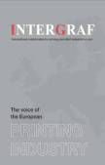







How to reach the consumer?
Notes:
9
9

Slide 10
Print remains attractive
Addressed direct mail is cited as the top medium for delivering ROI with 52% rating it as very effective. (Mail Media Center, 2009)
How Shoppers Want to Receive Advertisements in the Future (Nielsen Media Research, 2011)
Direct Mail | 87%
Newspapers | 86%
In-store print advertising | 86%
Store websites | 75%
Email from retailers | 72%
Store website using tablet | 59%
In-store kiosks | 43%
Televisions in stores | 42%
Social media site | 37%
Smart phone or mobile phone | 31%
75.9% of survey respondents think print is as effective or more effective than the internet for marketing. (PrintWeek 2012 survey)
42% of consumers prefer to receive financial services bills by post. Consumers say that postal bills offer better record keeping (69%), are easier to check (65%), offer more security (48%). (TwoSides survey, July 2013)

Slide 11
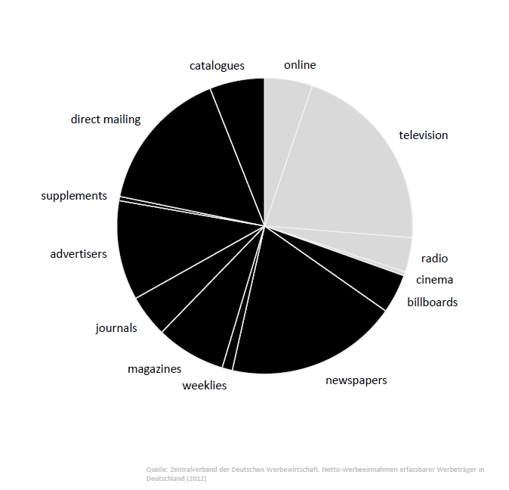
Print remains main advertising support
63% trust advertising in newspaper/magazines, whereas only 25% trust advertising on the internet.
(PrintPower/VTT survey, March 2013)
About 60% of respondents consider advertising in magazines is more appropriate and less disruptive than in other media. (Media_Analyzer, August 2013)

Slide 12
Spending in printed advertising remains important
Worldwide share of advertising investments
Print = 34.2%
Print = 29.3%

Slide 13
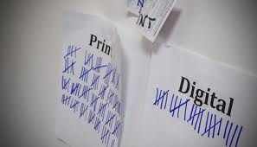
What are the advantages of print ?

Slide 14








Added value of paper in commercial and advertising products
AUTHORITY
CALL TO ACTION
ENGAGEMENT
COMPLEMENTARY
TO OTHER MEDIA
POSSIBILITY OF
BEING PRESERVED
CREATIVE
FLEXIBILITY
ABILITY TO
TARGET

Slide 15

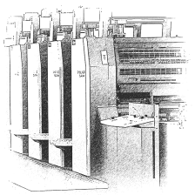
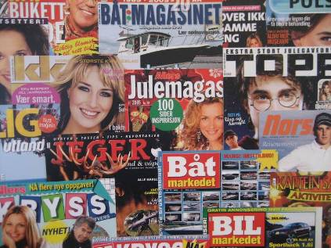

Print needs to change – and printers need to change
Providing just Print is no longer an option
Providing Print needs to change to…
offering added value
offering additional services
offering customer solutions
offering communication solutions

Slide 16
Printers have to become real service – providers!

Slide 17
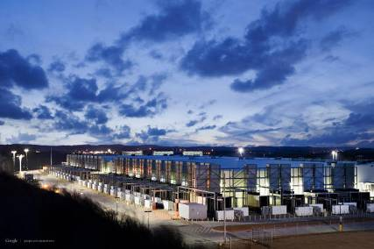

What about the environment ?

Slide 18
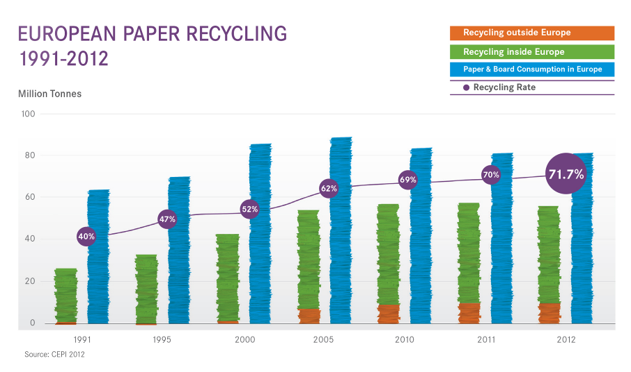
Paper and print have a positive story to tell

Slide 19
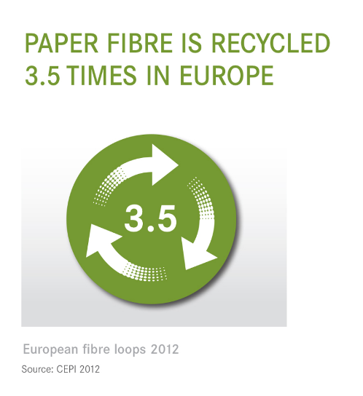
Paper and print have a positive story to tell

Slide 20
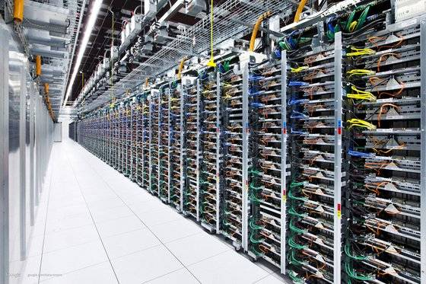
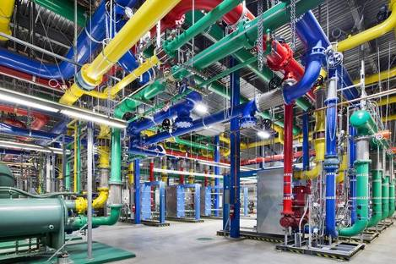

Electronic = Sustainable
is a myth!
Google Data Centres

Slide 21
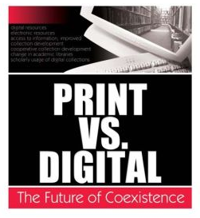
Can print and digital coexist ?

Slide 22

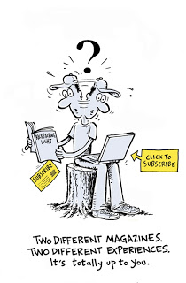
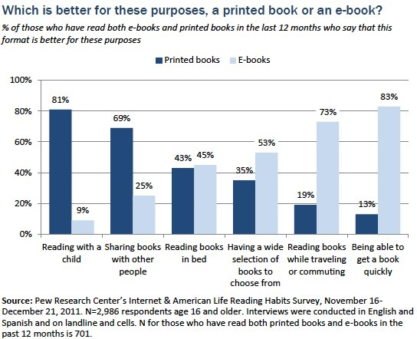
Different media for different needs

Slide 23


Not print OR digital but print AND digital
60% of people make an online purchase within a week of receiving a catalogue.
(Source: Royal Mail’s Market Reach initiative, 2013)
44.8% of consumers expect that the standard way to receive a bill is both postal mail and electronic copy. (TwoSides survey, 2013)
Only 11% of those who read digital press don’t use paper anymore. (Gfk France, 2011)
90% of digital news shoppers wish to continue receiving paper at home or in store. (Nielsen media research, 2011)

Slide 24

Single Channel to media integration
E-mail Marketing
TV…ITV
Viral and online videos
TV
Radio
  Radio..online radio
Direct mail
Mobile Marketing
Online newspages
Events
PR
Directories
Single-channel media world
media convergence
Social networks
Media channels today
Newspapers
Digital magazines
Internet search pages
Magazines
Direct marketing
Magazines
Tablets
Microblogging
Online games
Events, PR
Newspapers
Outdoor
Digital Newspapers
Cinema
Internet banners
Outdoor, posters
Marketers are looking for the best marketing mix to reach the best audience aggregation

Slide 25
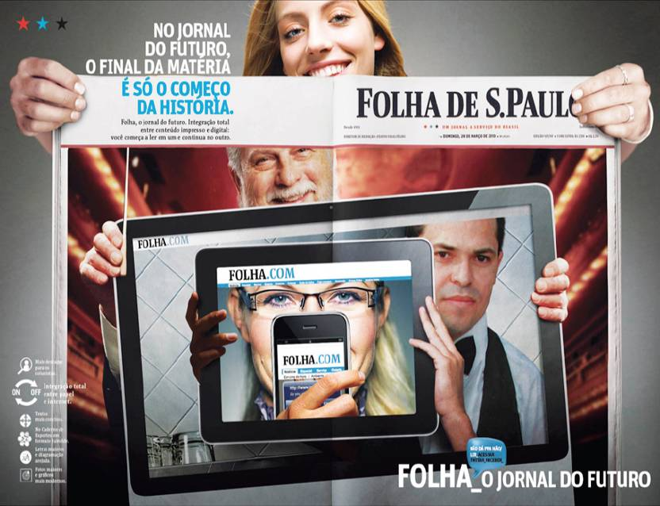
Print + digital = success story
Notes:
Benez from Brazilian newspaper house Folha De S Paulo
concentrate on the print+digital platforms .
He spoke about the transition from newspaper to newsmedia.
Benez mentioned that a news media company must always be ready to deliver news and services through various formats - text, audio and video. Hence, content must be sent to all the platforms where the user is present, including internet, mobile and tablets. This convergence, he said, was embraced by the Folha Group with many different innovations which were useful for both the advertisers as well as the publishing house. For example, the newspapers were launched in the HTML5 format for the digital platform.
However, quality is non-negotiable (journalism). The subscription, he said, increased as and when there were new launches in the digitisation of content. After the launch of the HTML5 version, the subscriptions increased by 89.81 per cent, while after the launch of the new digitised version, it grew by 253 per cent.
He mentioned that the important methods to maintain and increase the revenues of the company include exclusive online ads, cross media ads and multi-platform special projects.
He concluded his presentation by highlighting three major lessons of the publishing house - to break the paradigms, be where the readers are and offer the advertisers whatever they need.
.

Slide 26

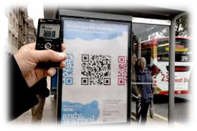
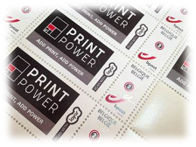




Coexistence of print and digital in practice

Slide 27
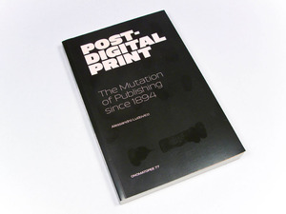
Looking at the future ?

Slide 28
Coexistence of print and e-media gives innovation opportunities
Room for further innovation opportunities
DIGITAL
MOBILE
PRINT
SOCIAL MEDIA
Notes:
From Gerd Leonhard presentation, futurologist

Slide 29
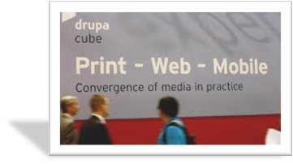

Coexistence of print and digital is vital for the European graphic industry
International confederation
for Printing and Allied Industries
European Federation
for Print and Digital Communication
bklose@intergraf.eu
Avenue Louise 130A,
BE - 1050 Brussels

